Slide 1
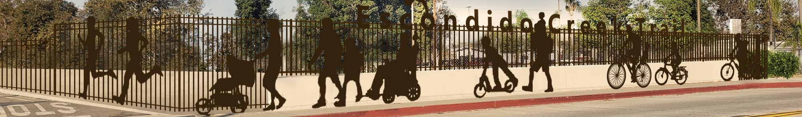


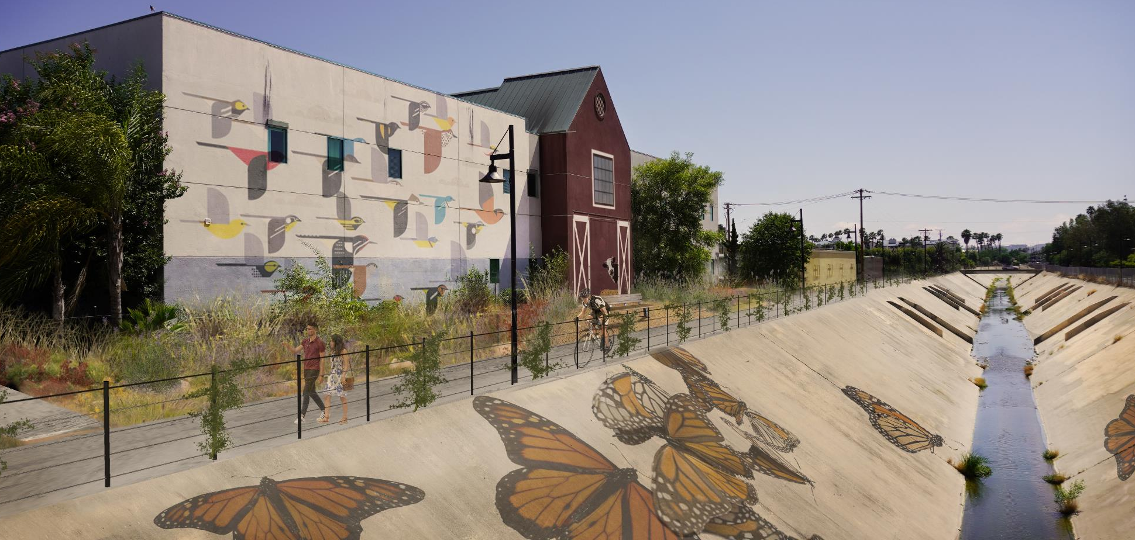
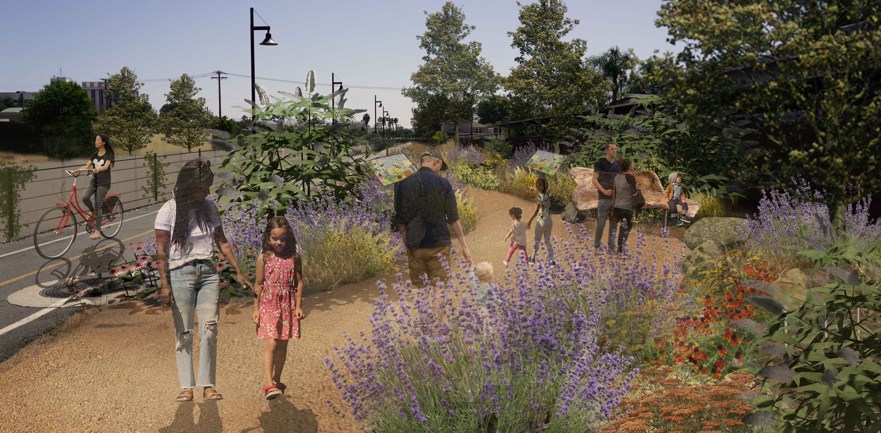
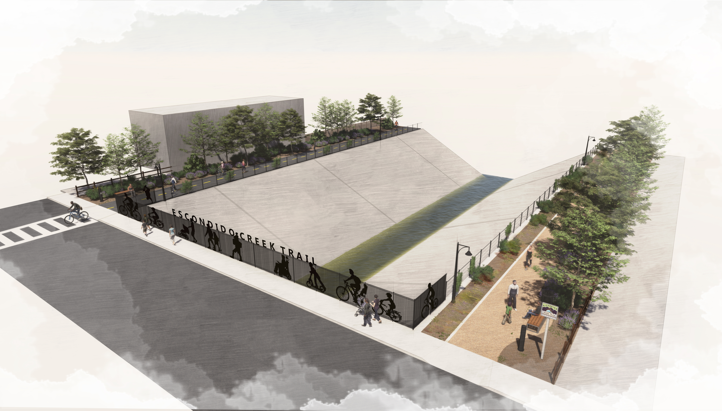
ESCONDIDO CREEK TRAIL EXPANSION & RENOVATION

Slide 2
ECT background
2010
REVEALING ESCONDIDO CREEK VISION PLAN
2012
ESCONDIDO CREEK TRAIL MASTER PLAN
2013
GRAPE STREET GATE ACCESS
2013
JUNIPER LIGHTING AND POCKET PARK
2014
PLAZA DEL ARROYO MURAL AND POCKET PARK
2015
HABITAT FOR HUMANITY ELM STREET IMPROVEMENT PROJECT
2017
ADOPT-A-CREEK PROGRAM BEGAN
2018
ATP-FUNDED STREET CROSSINGS IMPROVEMENT PROJECT BEGAN
2019
MISSING LINK PROJECT COMPLETED
2019
COMMUNITY OUTREACH & GRANT APPLICATION
2020
ESCONDIDO CREEK TRAIL EXPANSION PROJECT - PROP 68 STATEWIDE PROGRAM GRANT
DESIGN
ENVIRONMENTAL
CONSTRUCTION
2021 - 2024

Slide 3
Current Project Goals
Increase access to parkland and expand park spaces - especially in underserved areas of the community
Change the narrative and create a premier linear park
Soften, shade, landscape & beautify the creek corridor
Consistent look and branding
Engage the community

Slide 4
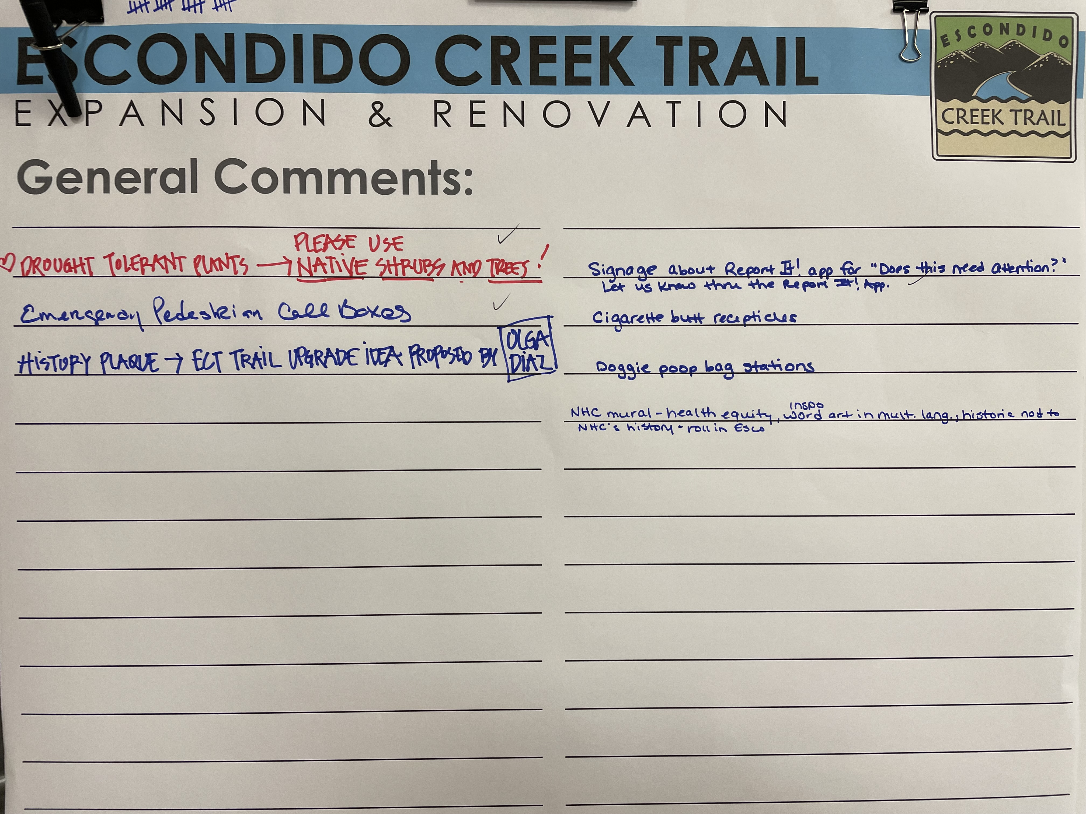
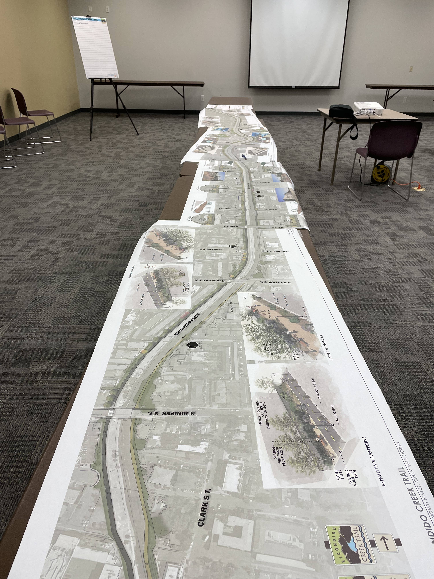
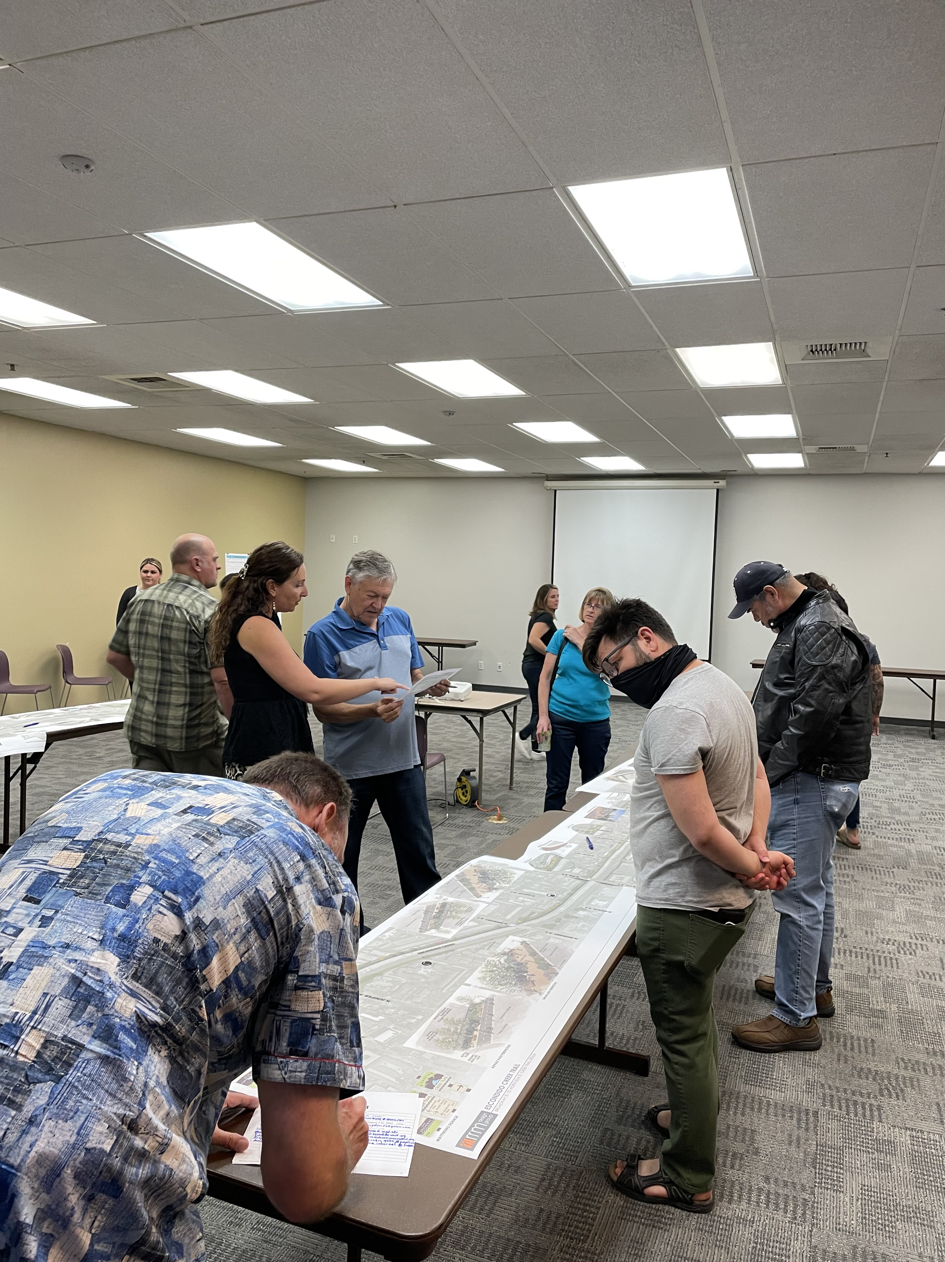
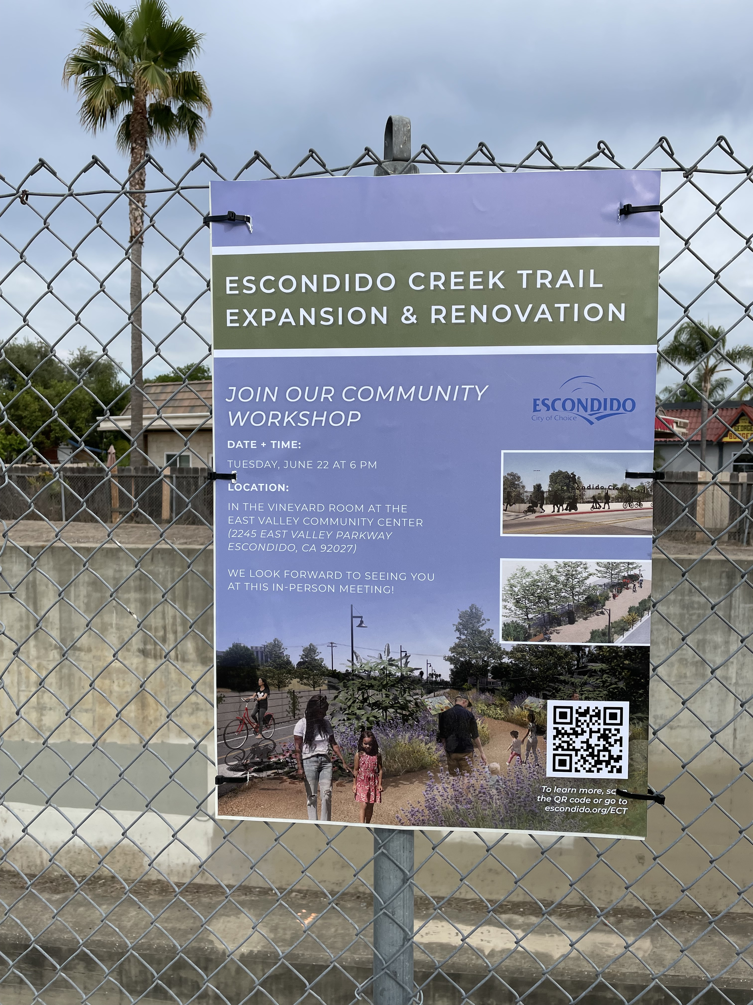
PUBLIC OUTREACH

Slide 5
schedule
STAKEHOLDER MEETINGS
(VIRTUAL)
SCHEMATIC DESIGN
CONSTRUCTION DOCUMENTS 60%, CEQA / NEPA,
90%, 100%, BID SET PLANS
BID AND CONSTRUCTION
SEP 30, 2020 OCT 3, 2020
NOVEMBER THRU DECEMBER 2020
SPRING 2021 THRU SPRING 2022
SUMMER 2022 THRU SPRING 2024
DEC 10, 2020
JUNE 22, 2021
OCT 2021
JAN 2022
COMMUNITY WORKSHOP 1
(VIRTUAL-COMPLETED)
COMMUNITY
WORKSHOP 2
(IN-PERSON-COMPLETED)
PLANNING
COMMISSION
UPDATE
CITY COUNCIL
UPDATE

Slide 6
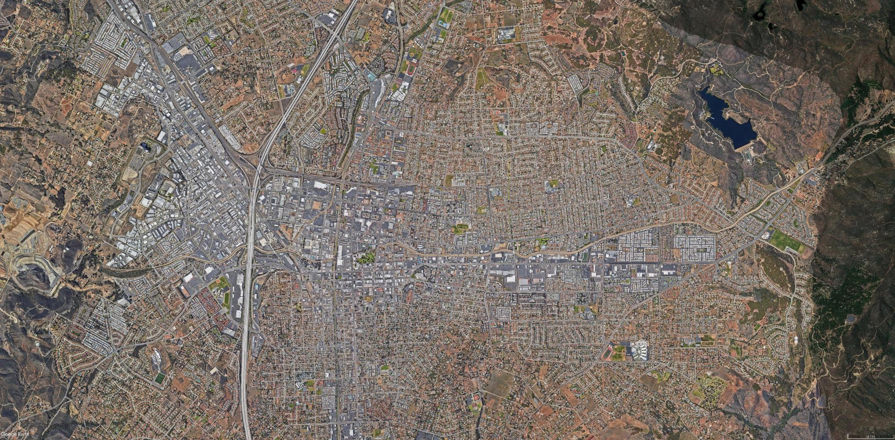

DALEY RANCH
78
DIXON LAKE
LAKE WOHLFORD
WASHINGTON PARK
GRAPE DAY PARK
MIDWAY
EL NORTE
15
BROADWAY
ASH
ROSE
FIG
CITRACADO PKWY EXTENSION
HARMONY GROVE DR
HARMONY GROVE
CENTER CITY PKWY
HISTORIC DOWNTOWN
TRANSIT CENTER
THE MISSING LINK
ALONG VALLEY PKWY
PRIMARY
SECONDARY
MINOR
North
SECONDARY
MINOR
1 mile
PROPOSED GRANT IMPROVEMENT OVERVIEW

Slide 7
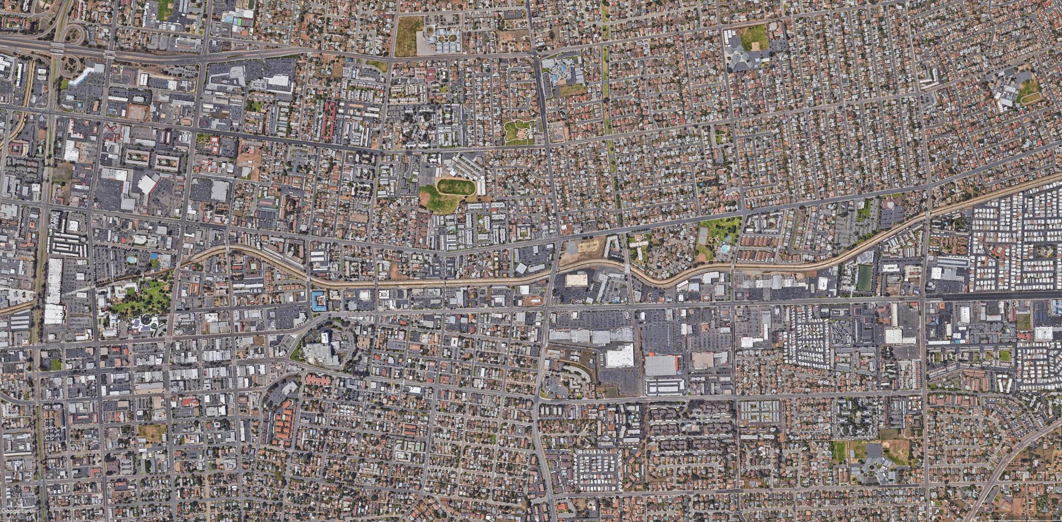
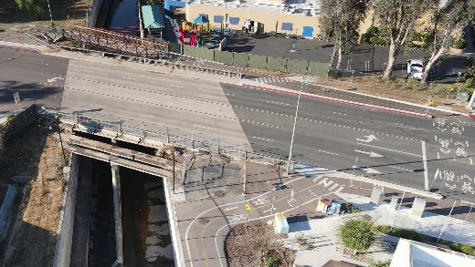
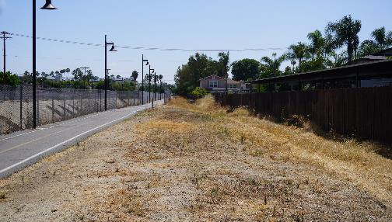
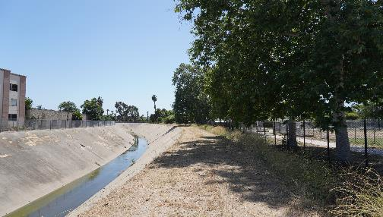
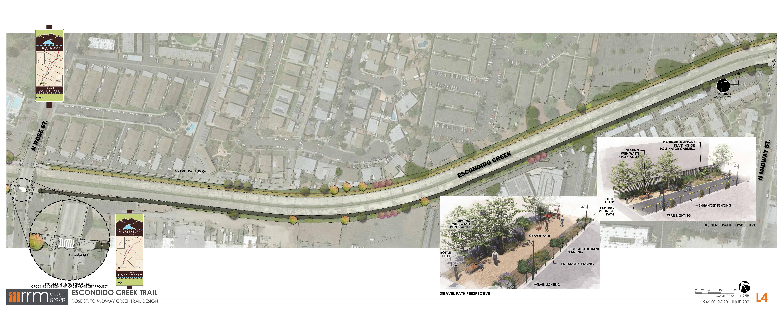
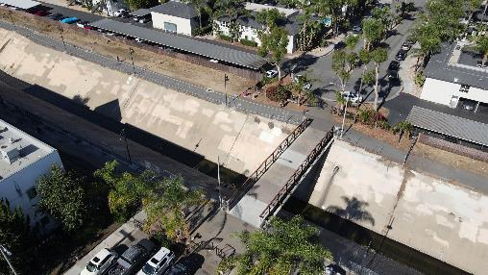
78
MIDWAY
WASHINGTON PARK
BROADWAY
HICKORY
HARDING
CENTRE CITY PKWY
GRAPE DAY PARK
ROSE
GRAPE
FIG
ELM
DATE
BEECH
ASH
JUNIPER
ROSE STREET
HISTORIC DOWNTOWN
THE MISSING LINK ALONG VALLEY PKWY
North
1 mile
PROPOSED IMPROVEMENT OVERVIEW

Slide 8
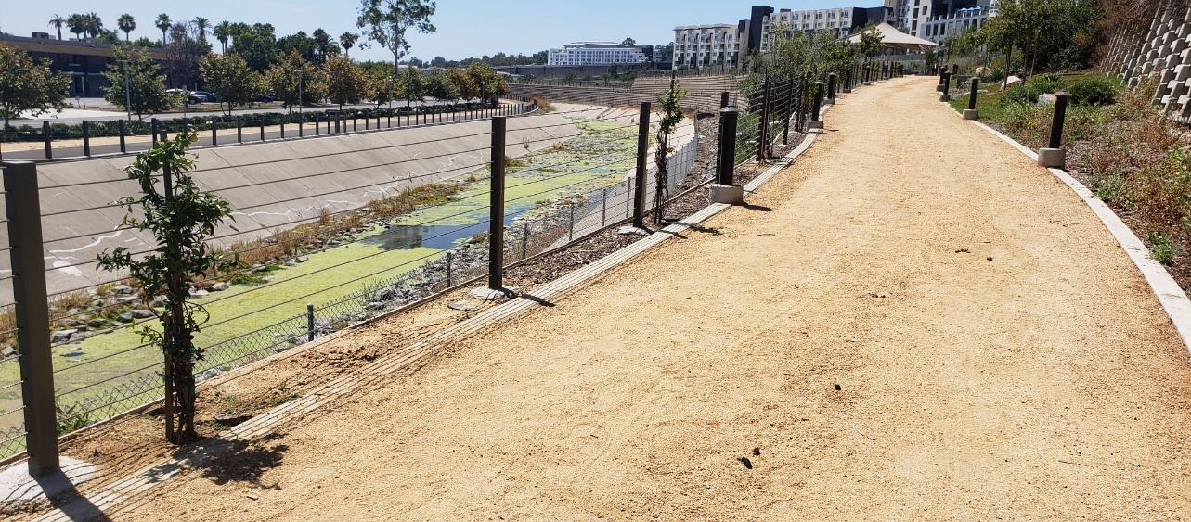
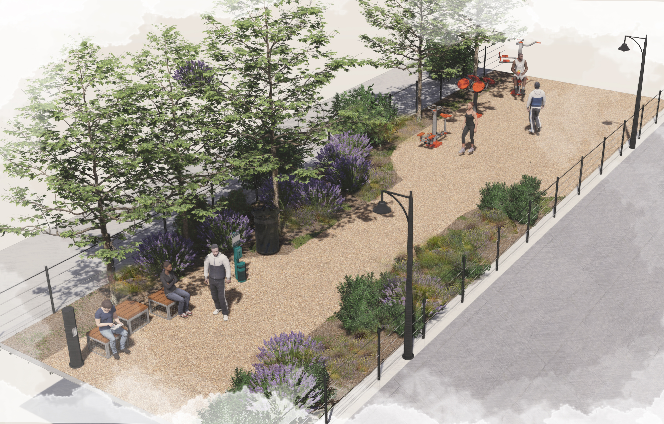
6
3
4
EXAMPLE IMAGE OF DECOMPOSED GRANITE TRAIL
5
IMPROVEMENT | DESCRIPTION
1 | DECOMPOSED GRANITE PATH
2 | SEATING AREA, WATER BOTTLE FILLER, WASTE RECEPTACLES, PET WASTE
3 | FITNESS STATION/ADVENTURE PLAY AREA
4 | NATIVE CALIFORNIA-FRIENDLY LANDSCAPING AND POLLINATOR GARDENS
5 | ENHANCED FENCING (Broadway to Rose)
6 | LIGHTING (Date to Midway)
2
1
NORTH SIDE
DATE STREET TO MIDWAY
PROPOSED: DECOMPOSED GRANITE TRAIL

Slide 9
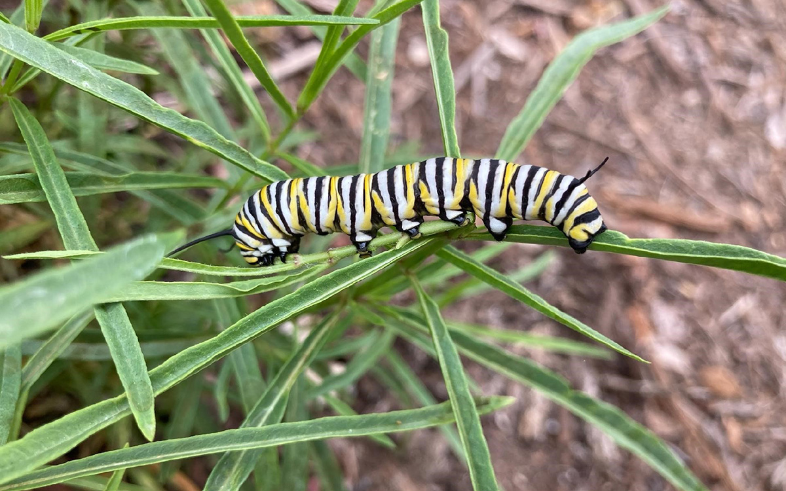
PROPOSED POLLINATOR GARDEN NEAR DATE STREET

Slide 10
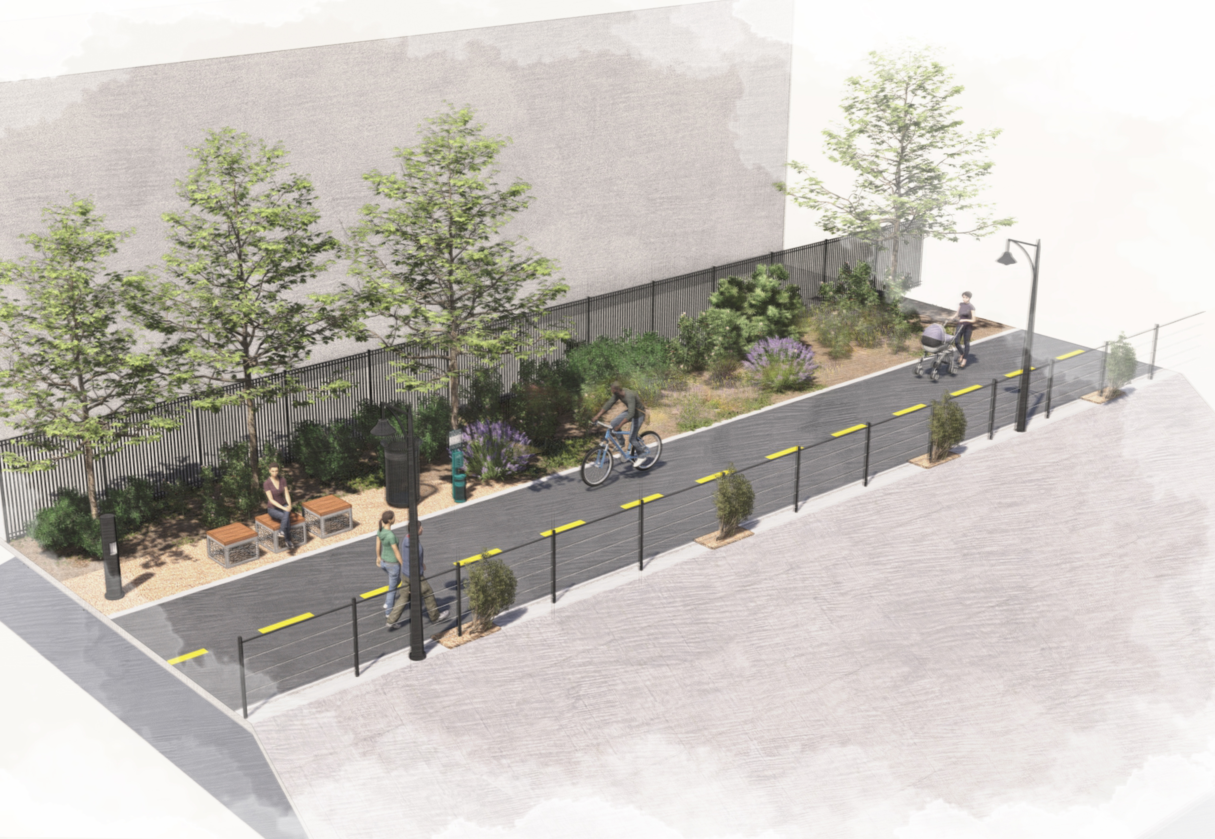
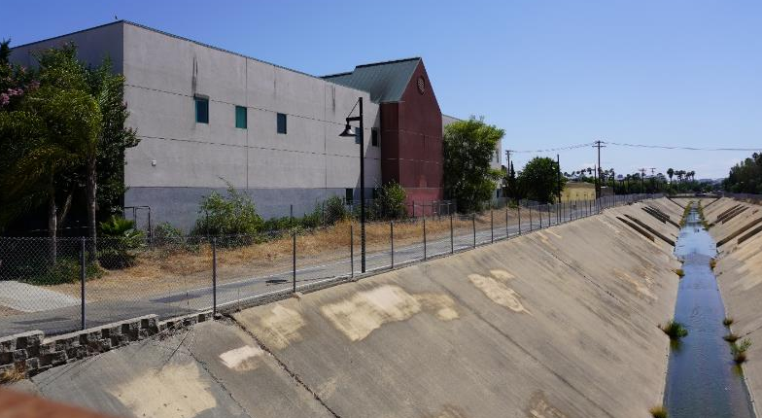
Concept for Neighborhood Healthcare Building
6
4
2
IMPROVEMENT | DESCRIPTION
1 | EXISTING PAVED PATH
2 | SEATING AREA, WASTE RECEPTACLES, PET WASTE
3 | WATER BOTTLE FILLING STATION
4 | NATIVE CALIFORNIA-FRIENDLY LANDSCAPING AND POLLINATOR GARDENS
5 | ENHANCED FENCING (Broadway to Rose)
6 | LIGHTING (Ash to Midway and Date to Rose)
3
5
1
BROADWAY TO ROSE
PROPOSED TRAIL: EXISTING PAVED CONDITION

Slide 11

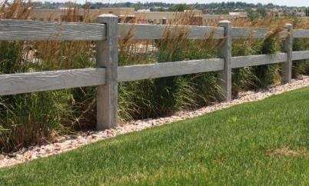
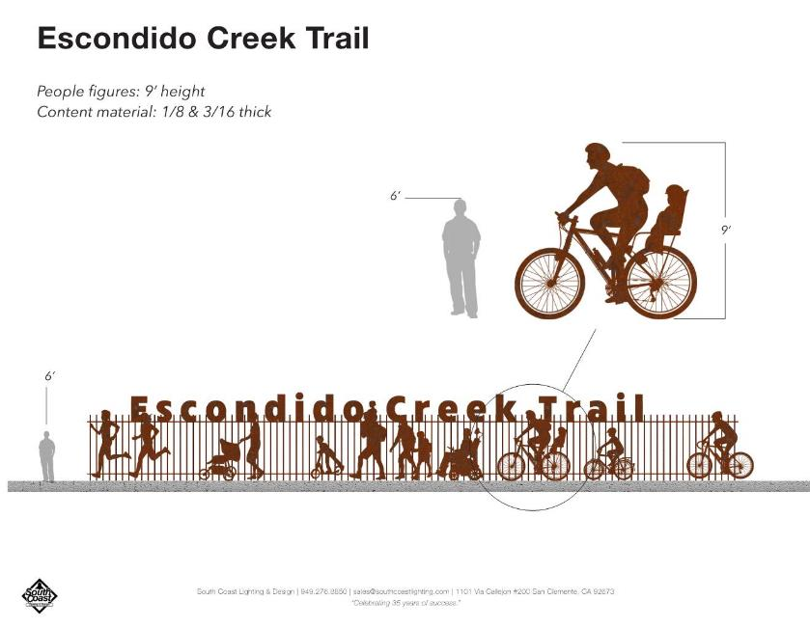
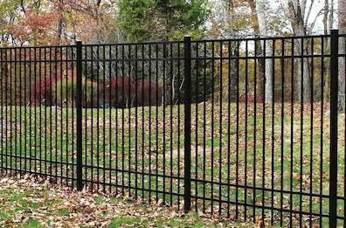

TYPE D: 4’ CABLE FENCE (BROADWAY TO ROSE)
TYPE A: SPLIT RAIL FENCE
TYPE C: ARTISTIC FENCE
TYPE B: 6’ METAL FENCE
*Image by RRM DESIGN GROUP and SOUTH COAST LIGHTING
PROPOSED FENCING DESIGNS

Slide 12
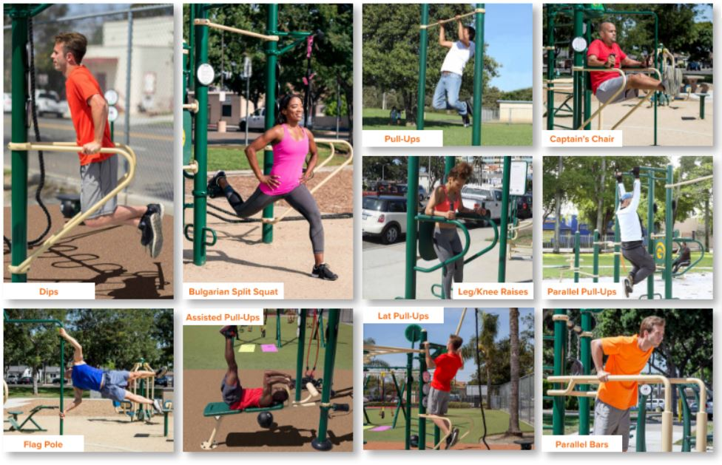
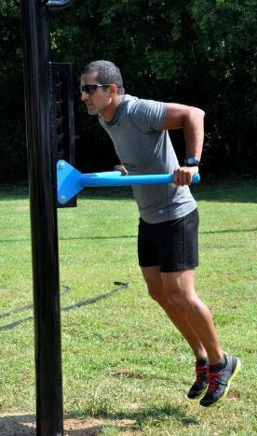
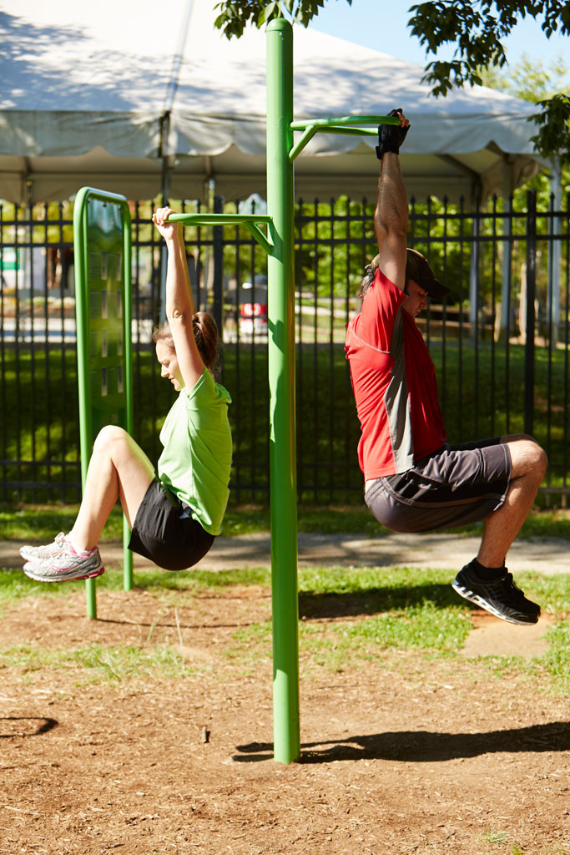
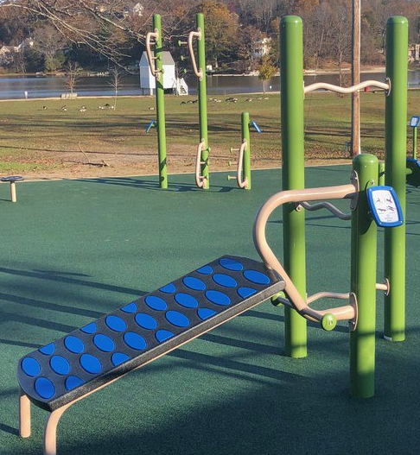
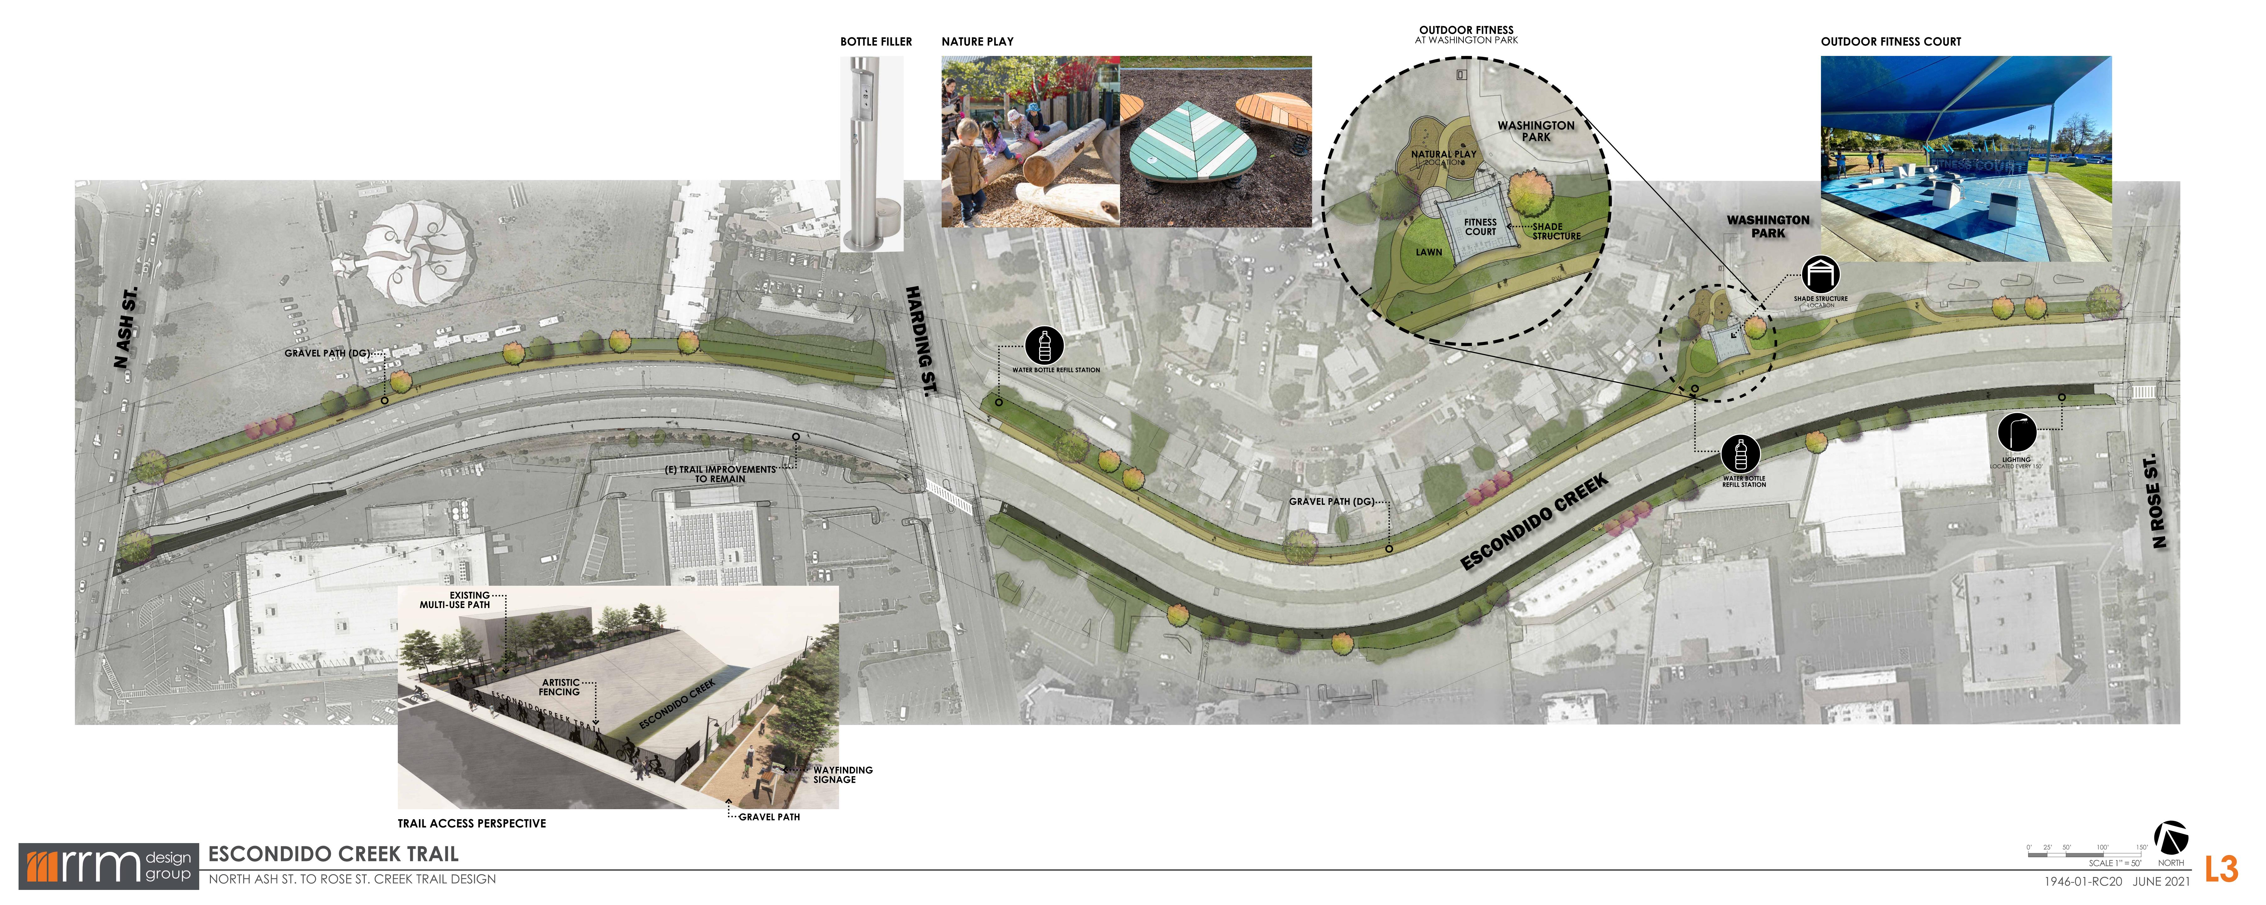
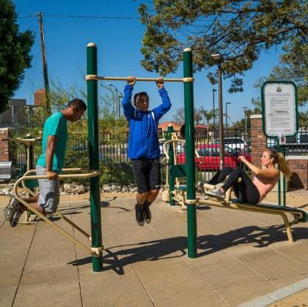
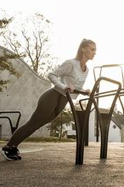
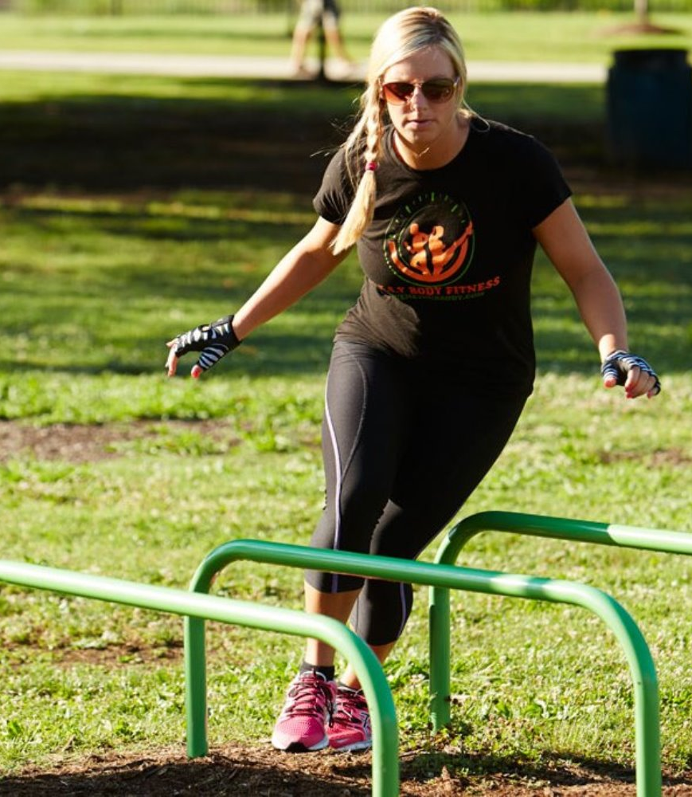
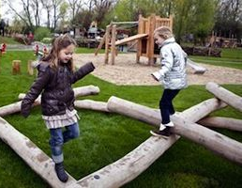

OUTDOOR FITNESS
OUTDOOR FITNESS EXAMPLES

Slide 13
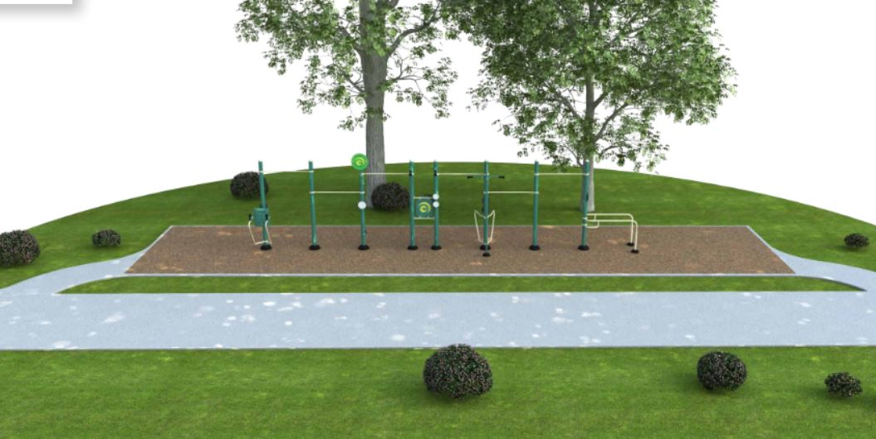
OUTDOOR FITNESS
OUTDOOR FITNESS EXAMPLES

Slide 14
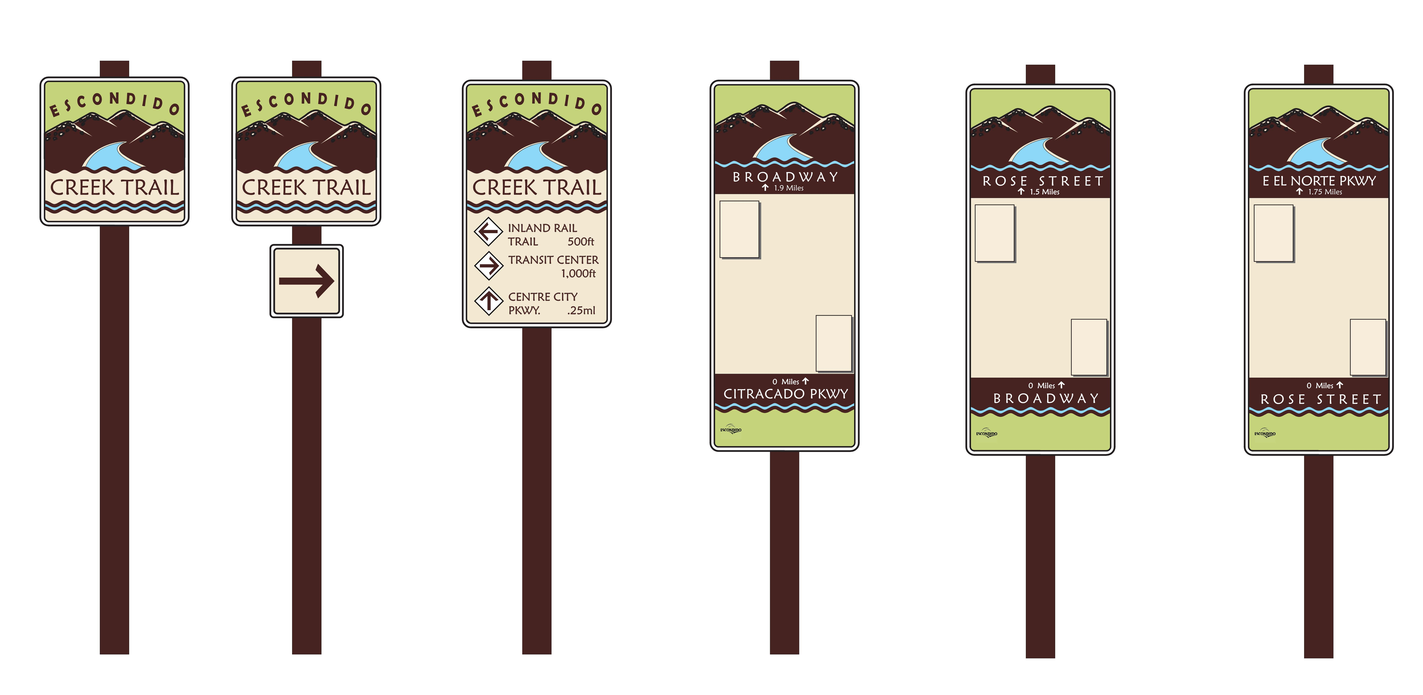
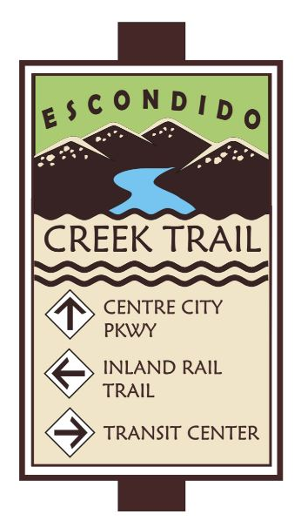
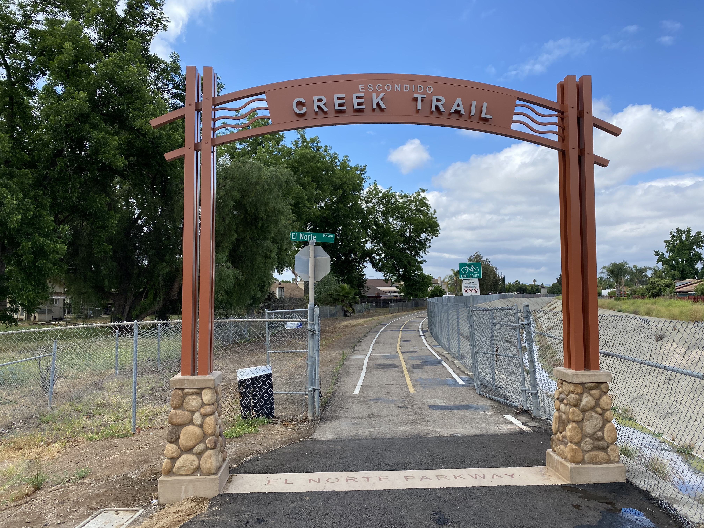
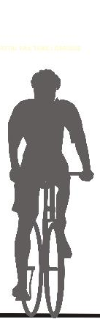
BRANDING & WAYFINGING SIGNAGE
El Norte Street Archway
SIGNAGE EXAMPLES

Slide 15
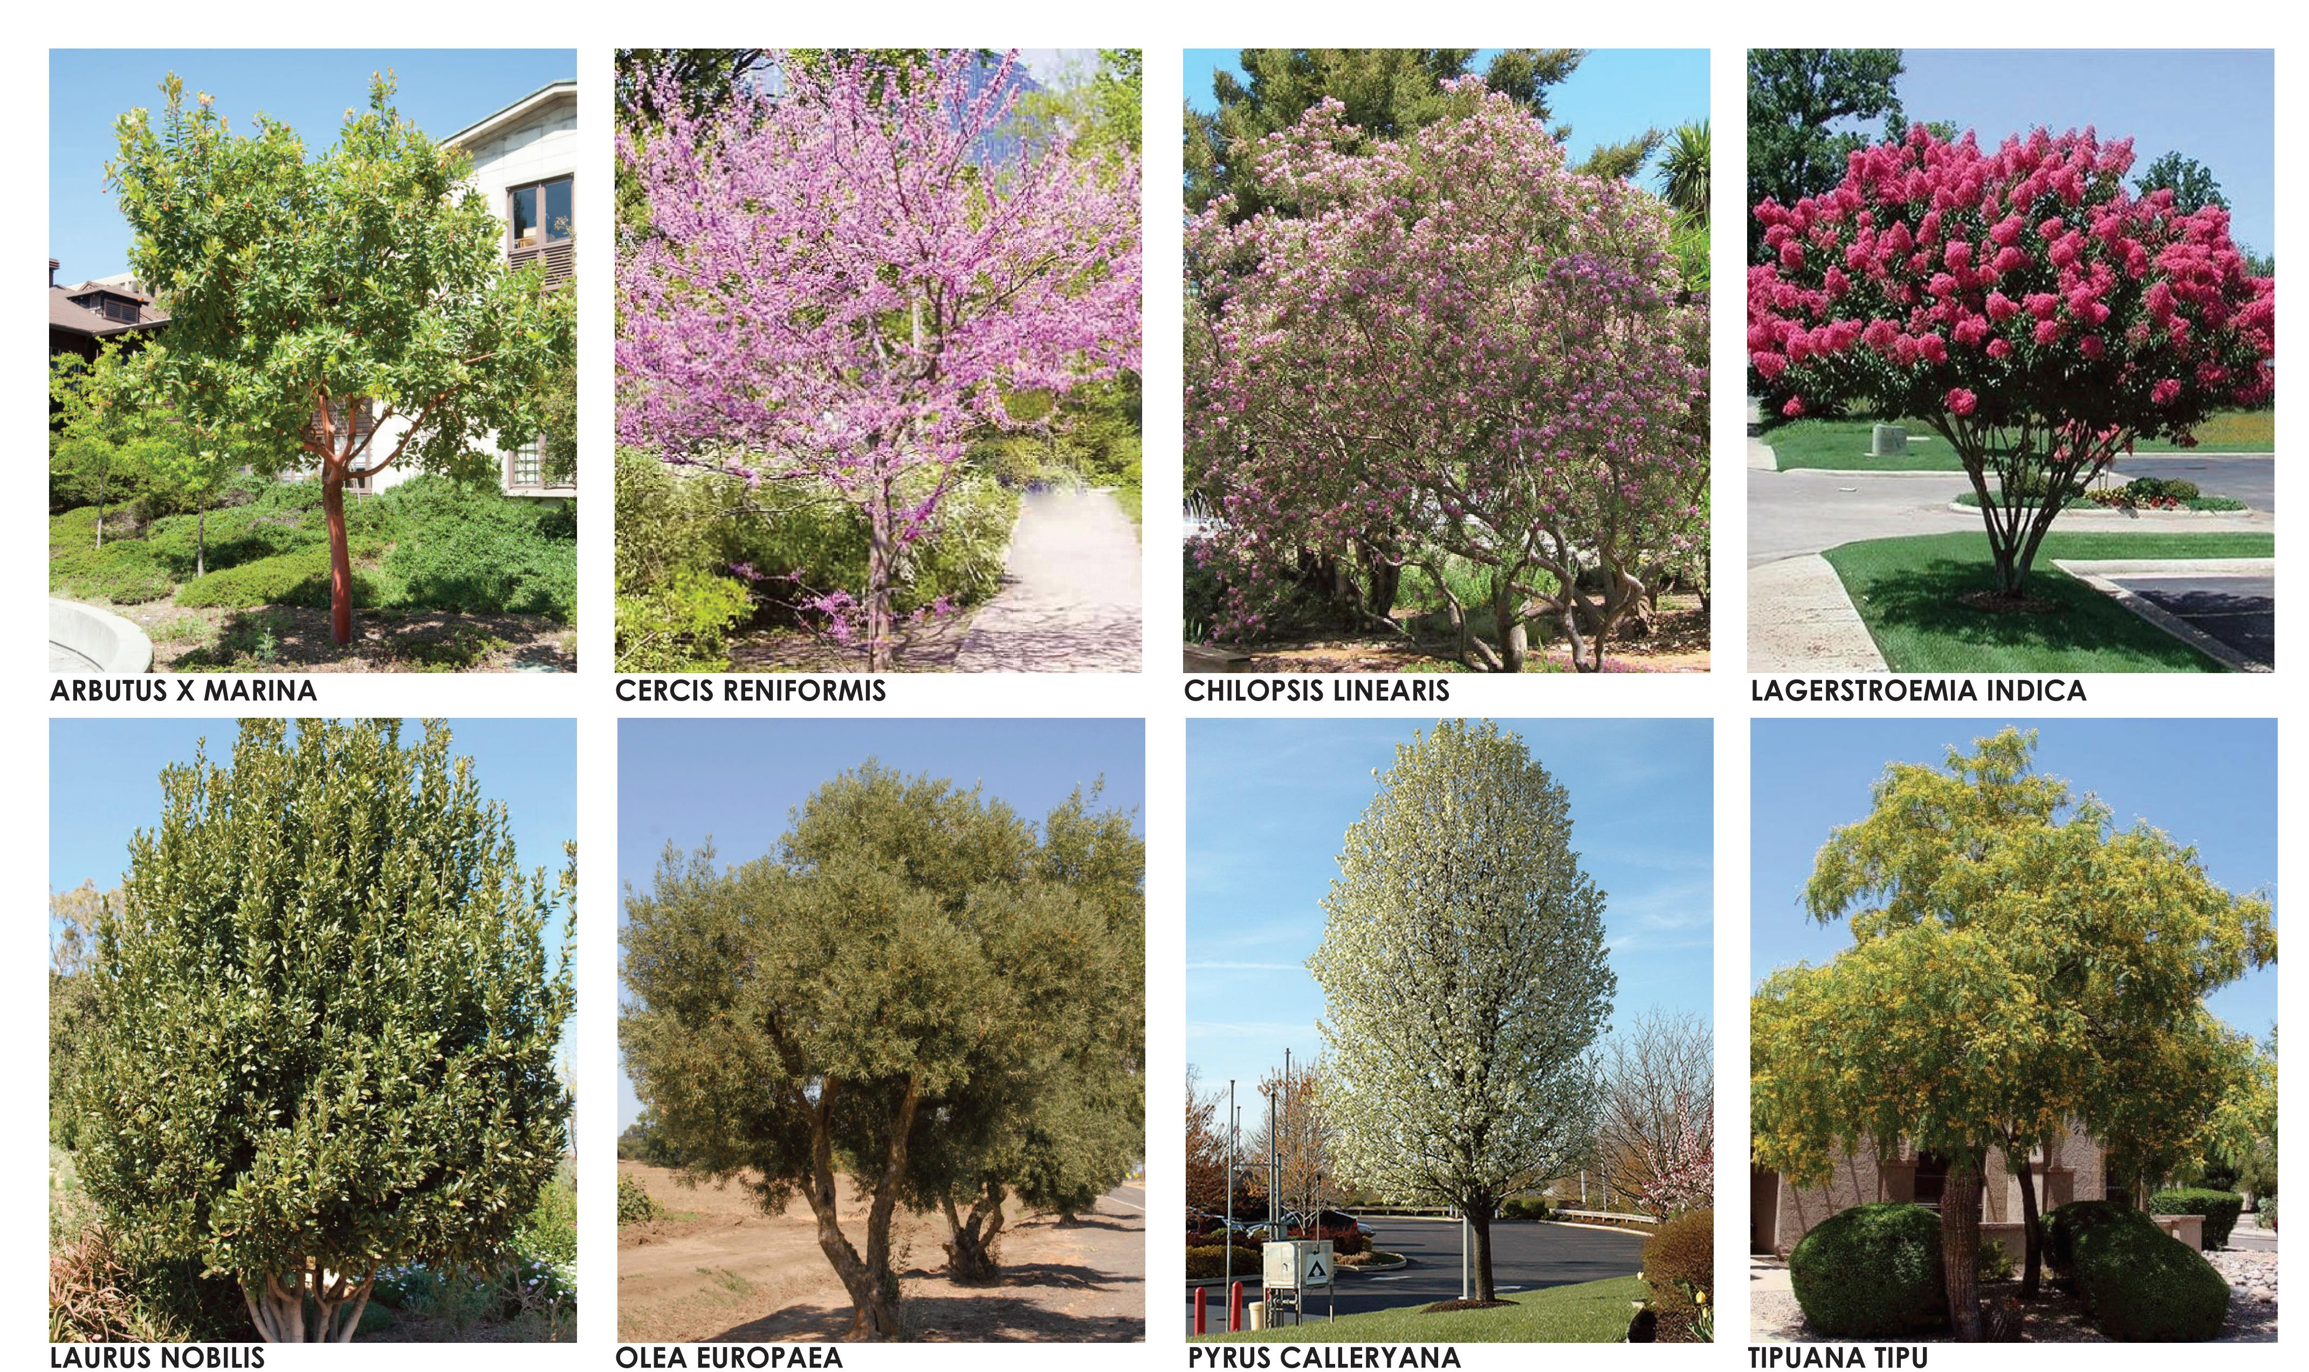
N
NATIVE AND CALIFORNIA FRIENDLY PLANTS

Slide 16
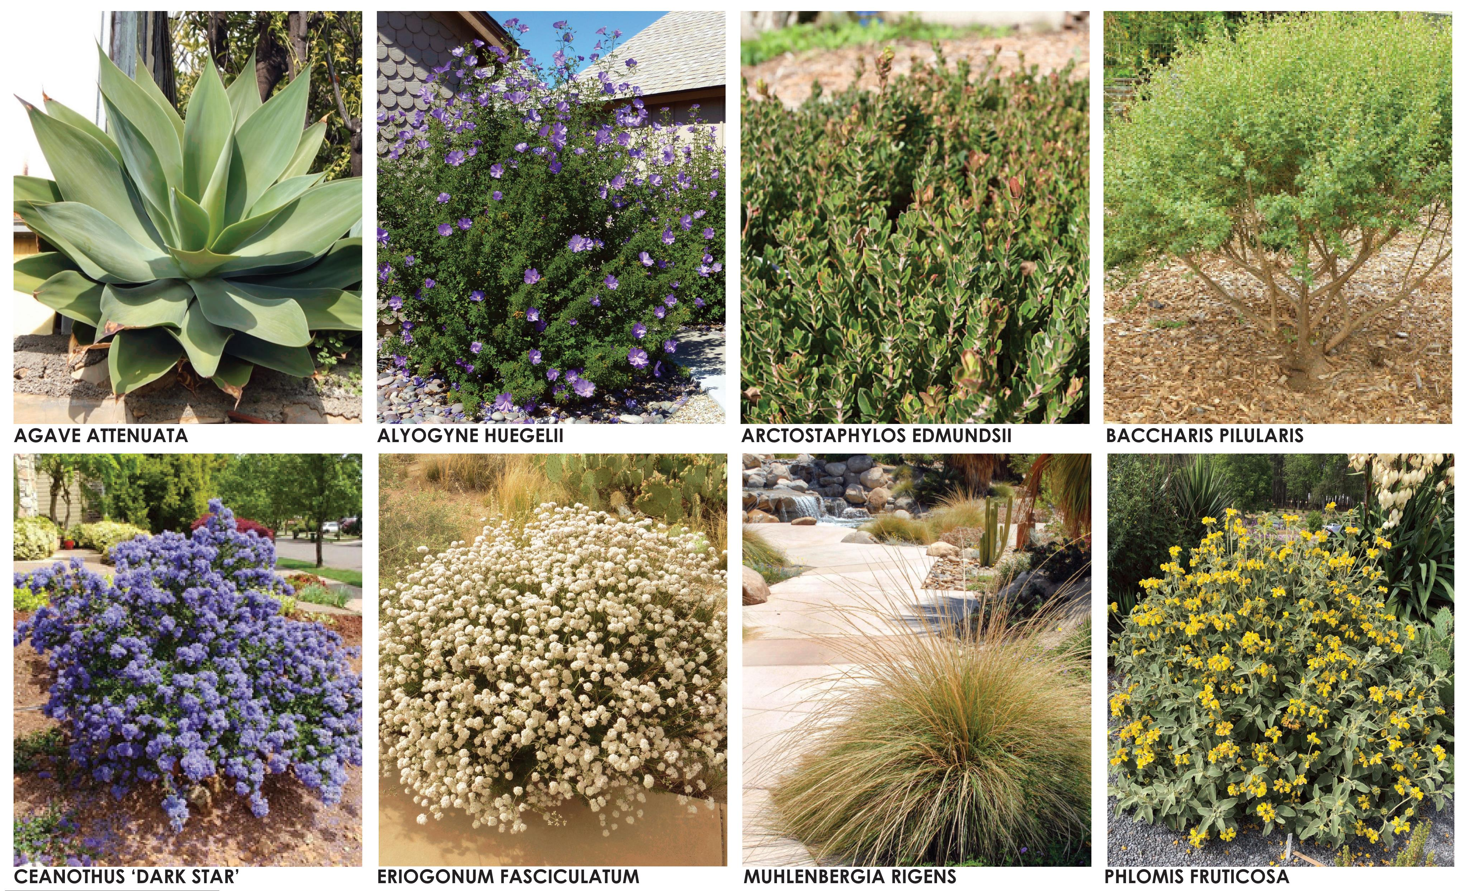
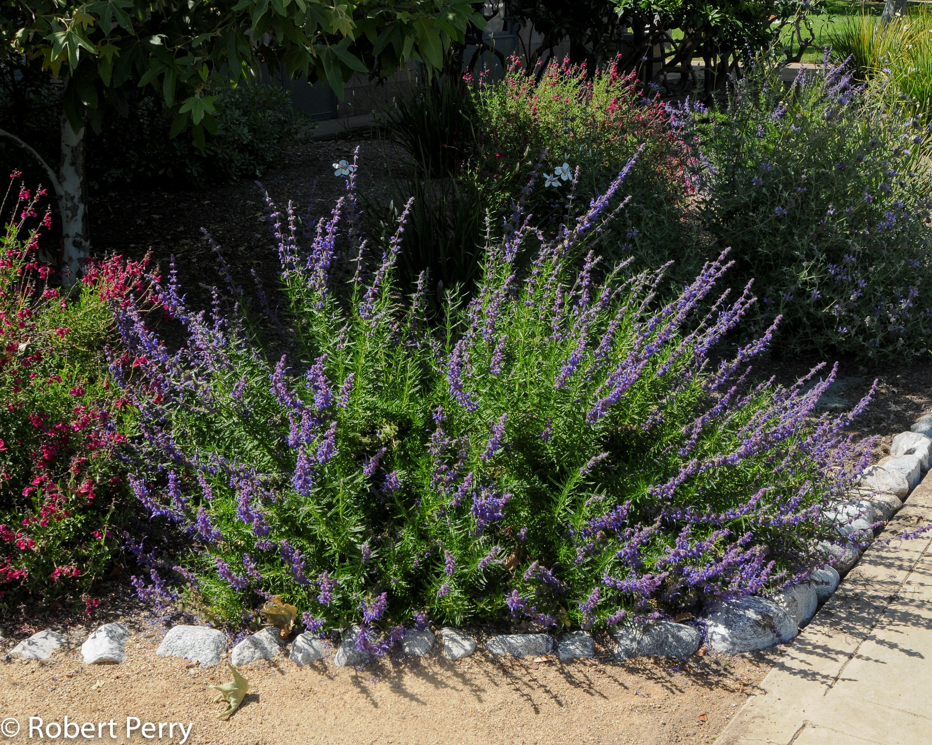
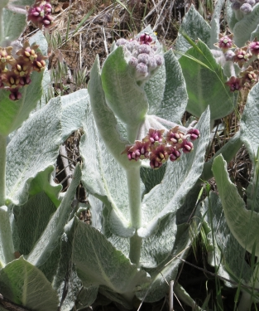
N
N
N
N
ASCLEPIAS CALIFORNICA
TRICHOSTEMA LANATUM
N
N
N
NATIVE AND CALIFORNIA FRIENDLY PLANTS

Slide 17
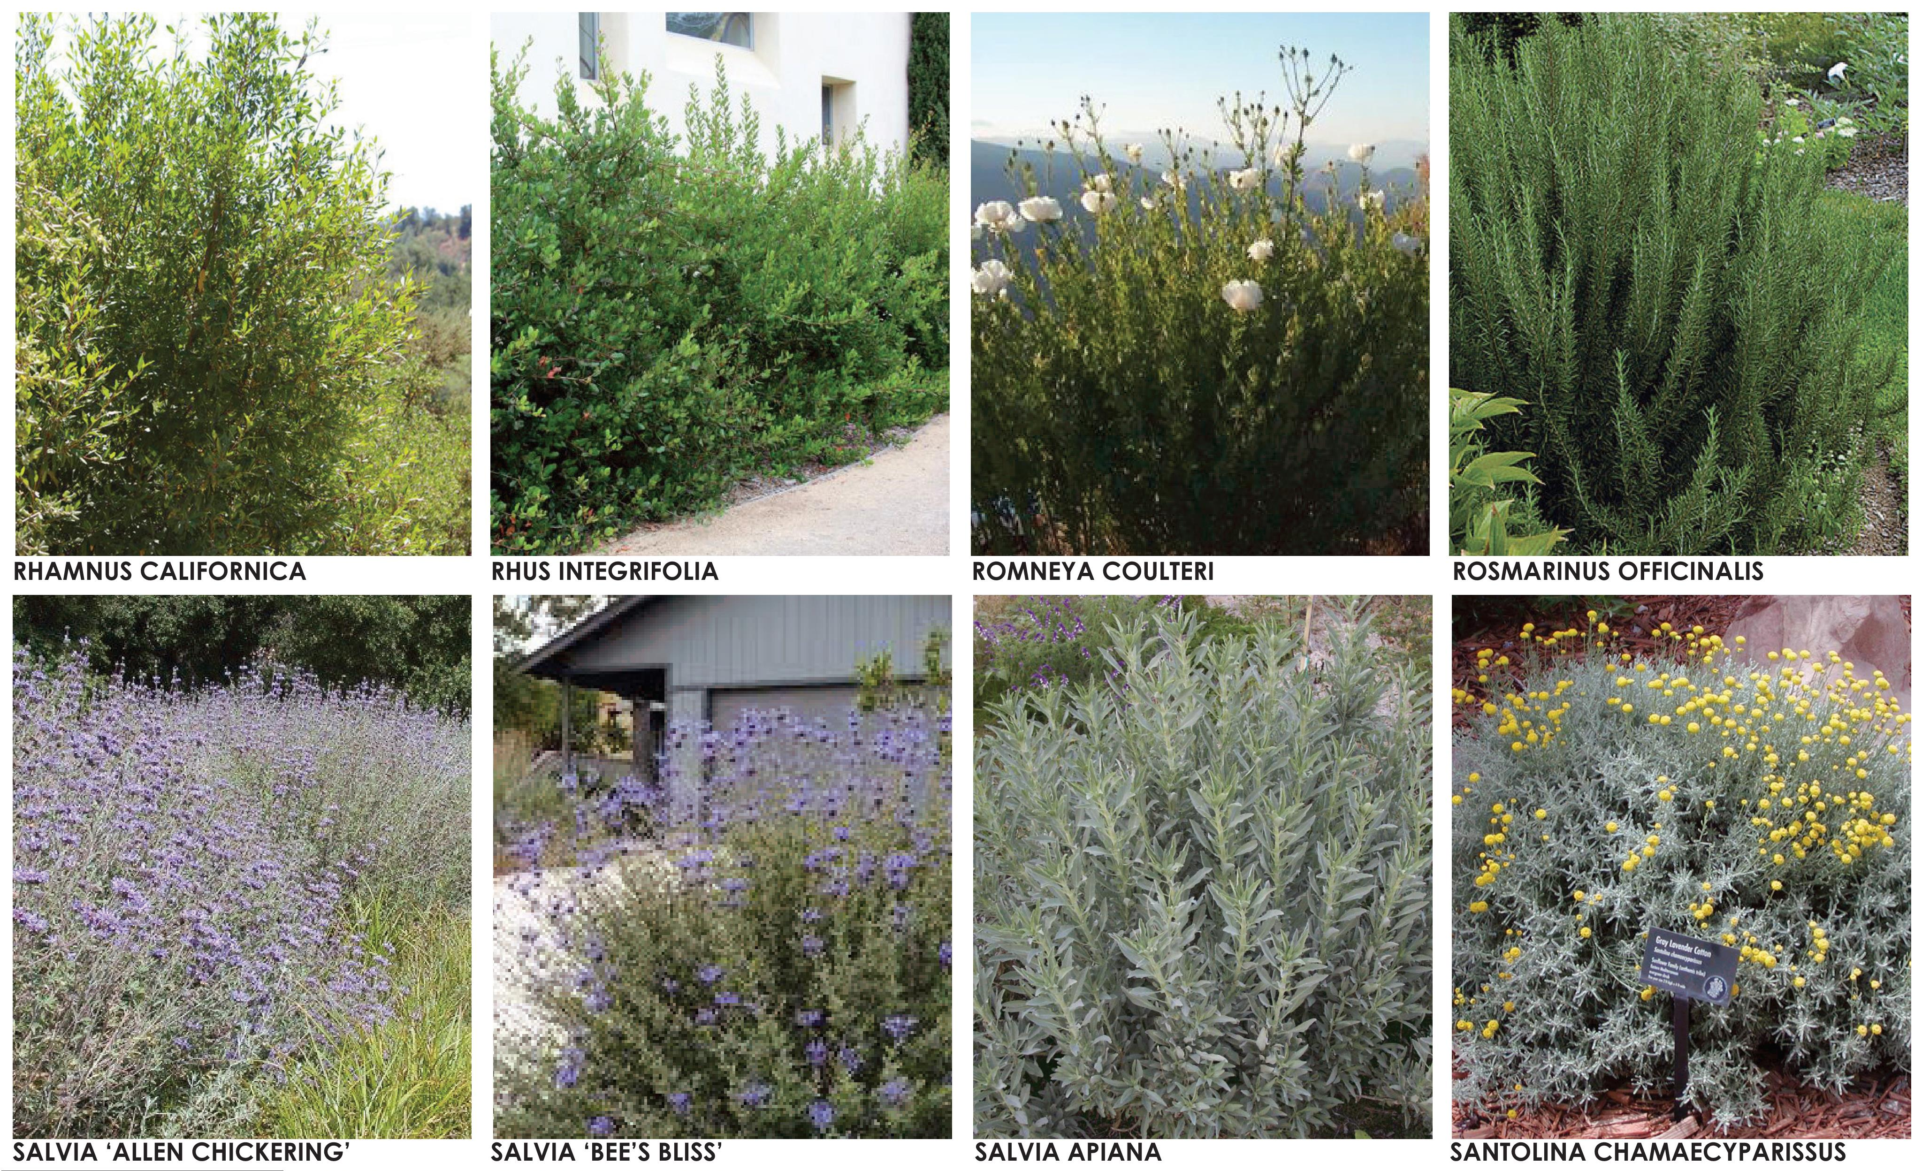
N
N
N
N
N
N
NATIVE AND CALIFORNIA FRIENDLY PLANTS

Slide 18






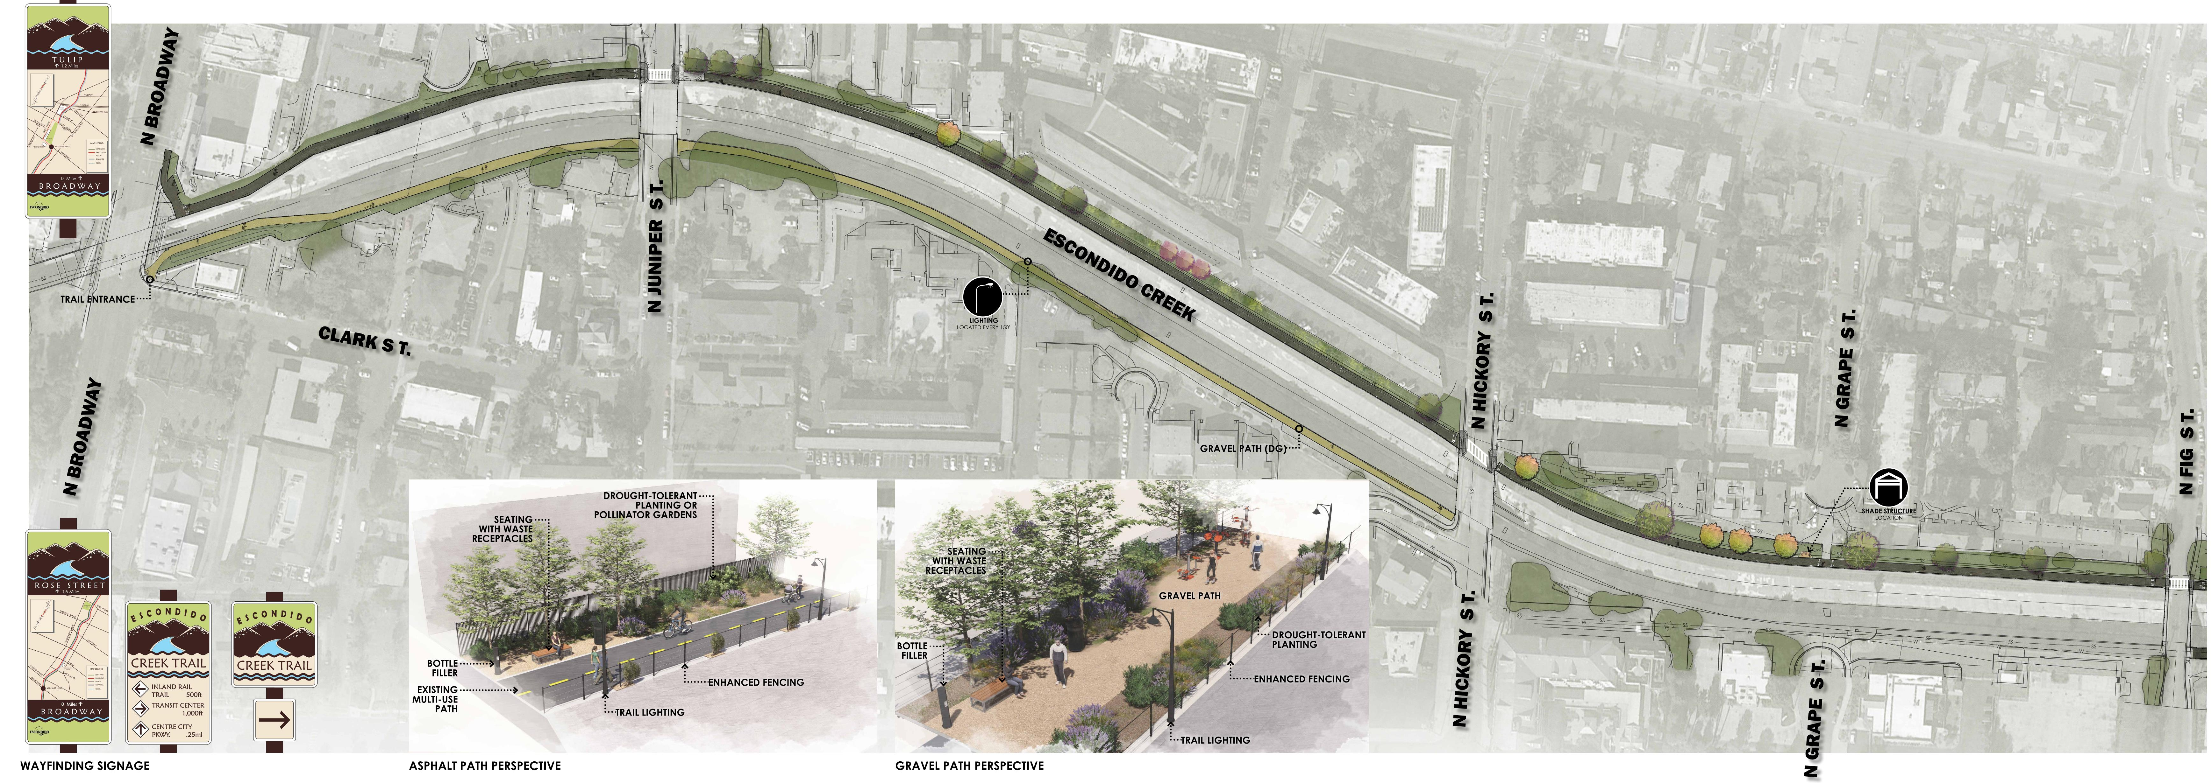
POLLINATOR GARDEN
WALL MURAL
LIGHTING
SHADE STRUCTURE
WATER REFILL STATION
SEATING
North
PROPOSED TRAIL ENHANCEMENTS
BROADWAY TO FIG

Slide 19

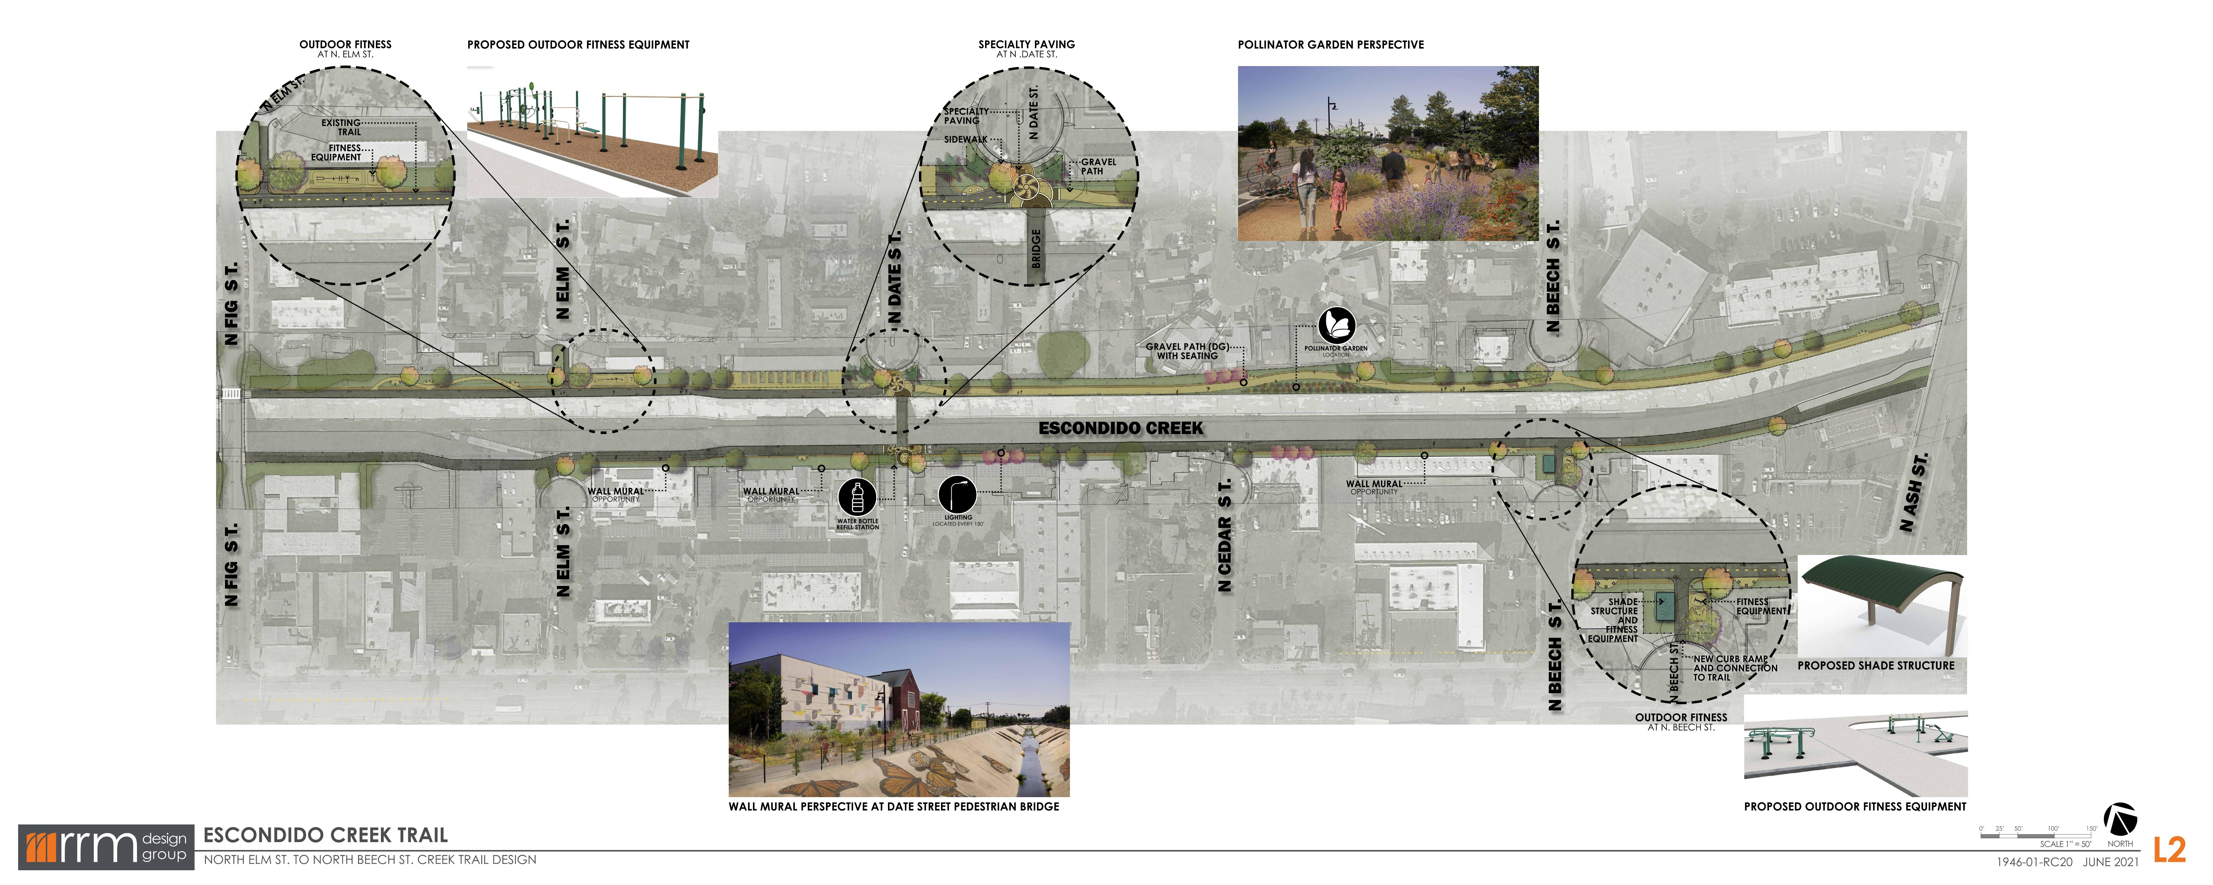
OUTDOOR FITNESS
LIGHTING
SHADE STRUCTURE
WATER REFILL STATION
SEATING
NATURE PLAY
POLLINATOR GARDEN
WALL MURAL
North
PROPOSED TRAIL ENHANCEMENTS
FIG TO ASH

Slide 20
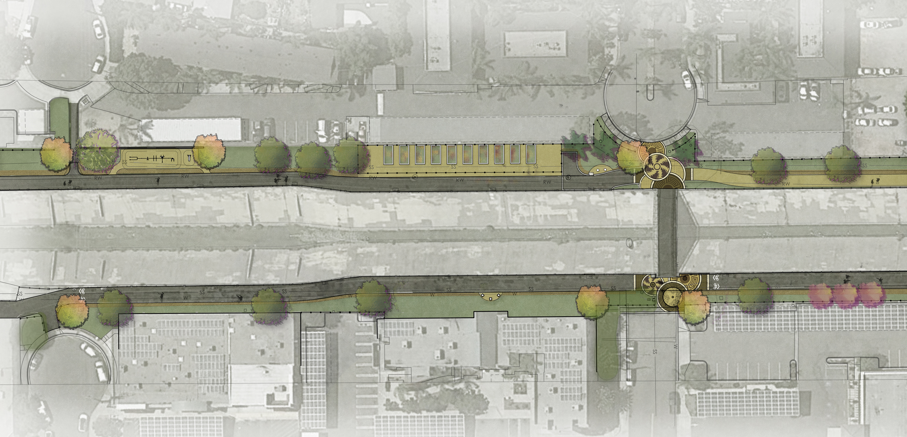
N. ELM STREET
N. DATE STREET
COMMUNITY GARDEN
DG PATH
FITNESS
PEDESTRIAN BRIDGE
E S C O N D I D O C R E E K
Future Wall Art
Neighborhood Health
S. DATE STREET
S. ELM STREET
North
PROPOSED TRAIL ENHANCEMENTS
DATE STREET CONNECTION

Slide 21
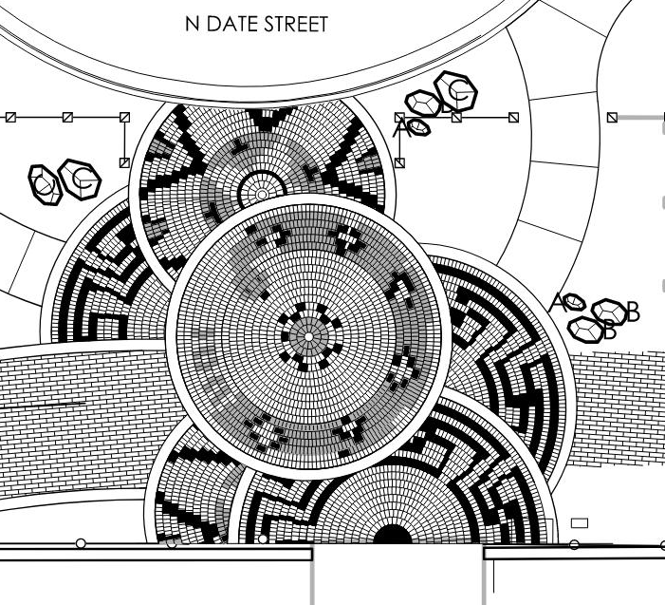
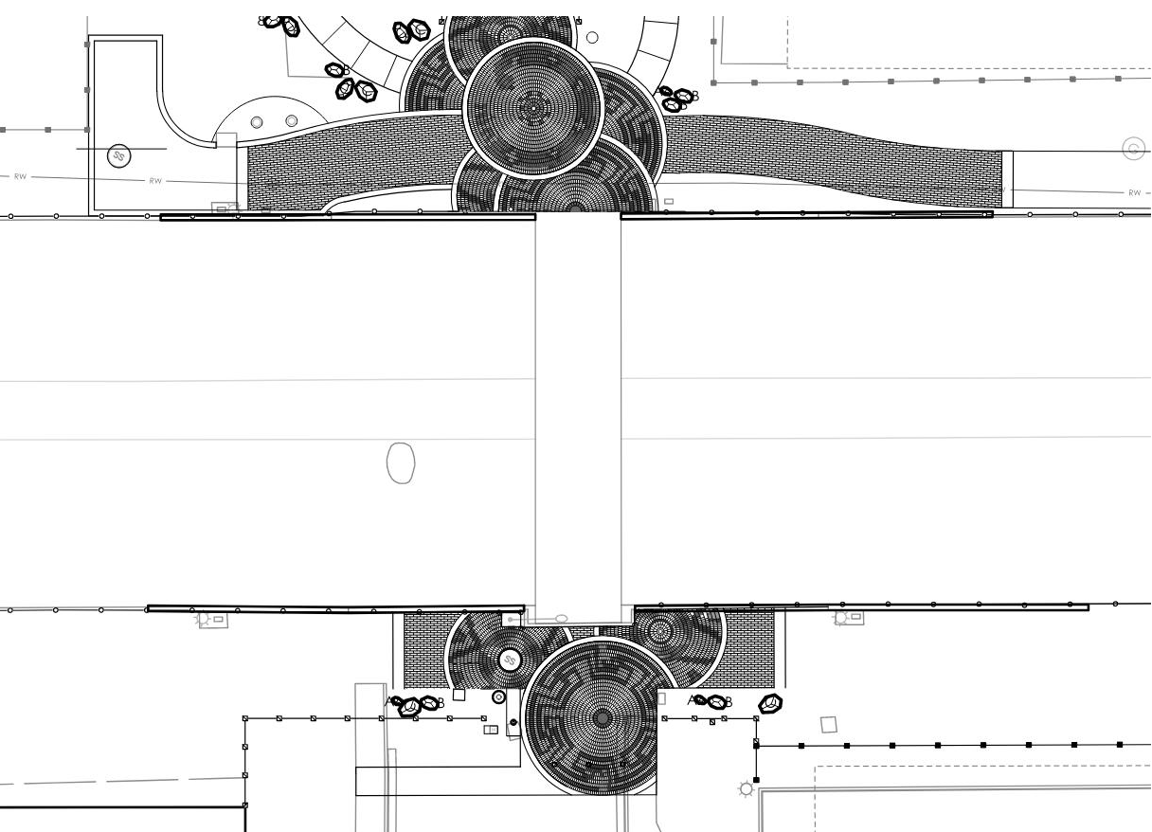
N. Date Street
E S C O N D I D O C R E E K
Pedestrian Bridge
S. Date Street
North
DATE STREET CROSSING – ENHANCED PAVING

Slide 22
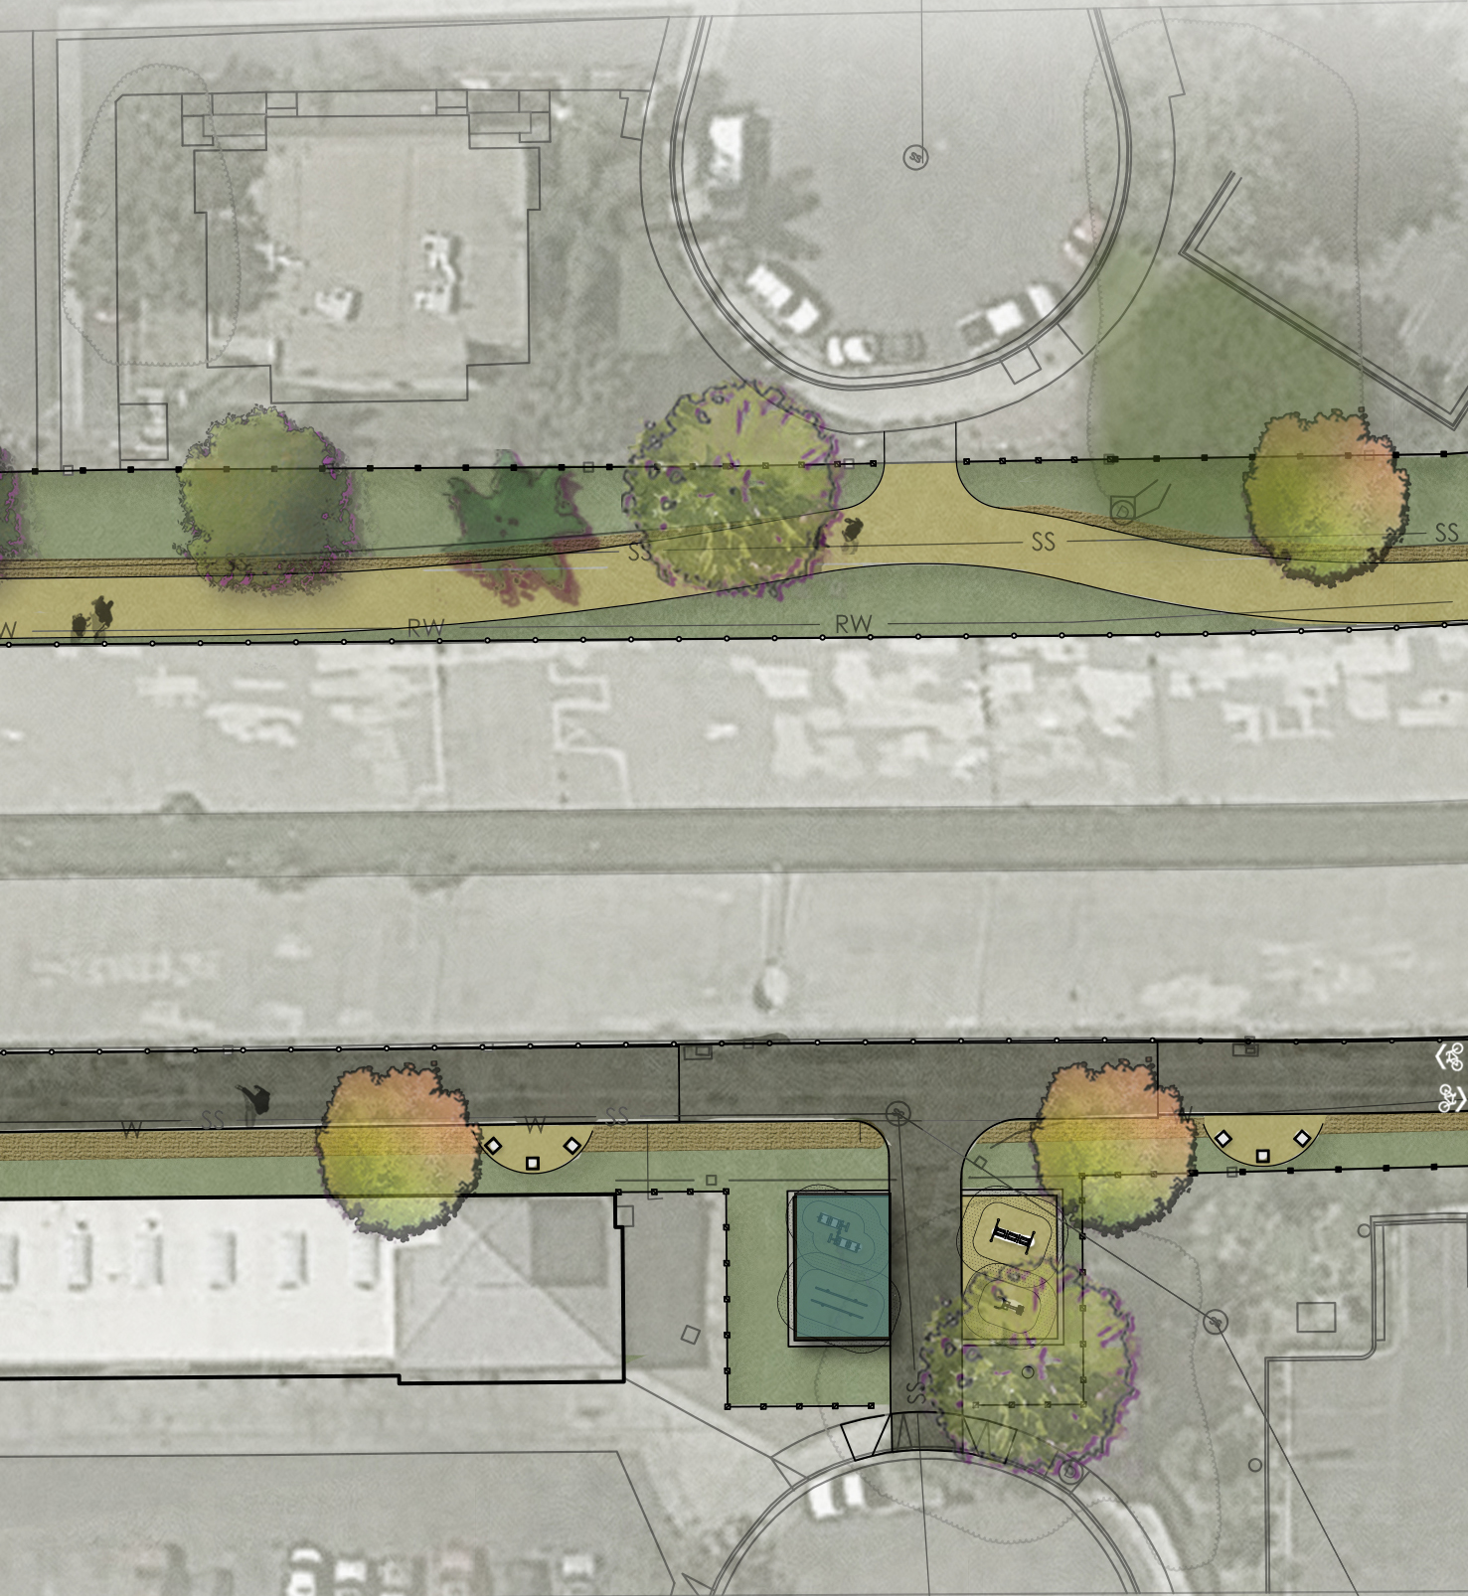
N. BEECH STREET
DG PATH
E S C O N D I D O C R E E K
FITNESS
North
S. BEECH STREET
PROPOSED TRAIL ENHANCEMENTS
BEECH STREET CONNECTION

Slide 23
OUTDOOR FITNESS
LIGHTING
SHADE STRUCTURE
WATER REFILL STATION
SEATING
NATURE PLAY
North
PROPOSED TRAIL ENHANCEMENTS
ASH TO ROSE

Slide 24
North
PROPOSED TRAIL ENHANCEMENTS
WASHINGTON PARK FITNESS COURT AND NATURAL PLAY

Slide 25
WATER REFILL STATION
LIGHTING
PROPOSED TRAIL ENHANCEMENTS
ROSE TO MIDWAY

Slide 26

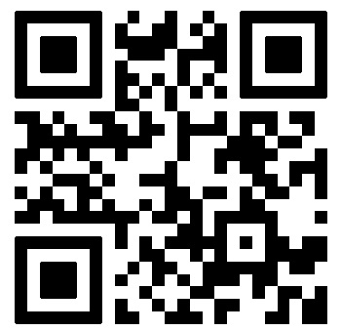
Thank you

