Slide 1

Redistricting in Escondido:
Public Input and Communities of Interest
Karin Mac Donald & Jane Hood
Q2 Data & Research, LLC
January 5, 2022

Slide 2
Today’s Agenda
Introduction & Background
Laws Governing Redistricting
Criteria for Redistricting
Process Timeline
How to Get Involved

Slide 3
Introduction and Background
In 2013, the City of Escondido transitioned from at-large to by-district elections for City Council
The City of Escondido now has 4 City Council districts
Members of the City Council must live in their district to be eligible to represent it
Voters in each district elect the City Council member for their district

Slide 4
Laws Governing Redistricting
U.S. Constitution
  Population Equality
Federal Law
  Voting Rights Act
California Elections Code
  Process and Criteria
Additional Requirement in Escondido
2013 Consent Decree

Slide 5
What are the mapping criteria?
Districts shall comply with the US Constitution, including reasonably equal population.
Districts shall comply with the federal Voting Rights Act.
Districts shall be contiguous and drawn to encourage compactness.
Districts shall respect the geographic integrity of neighborhoods and Communities of Interest (COIs).
  Communities of Interest may not include relationships to political parties
Districts should be easily identifiable and understandable by residents → follow natural and artificial barriers, streets, etc.
Districts shall not be drawn to favor or discriminate against a political party, incumbent or candidate.

Slide 6
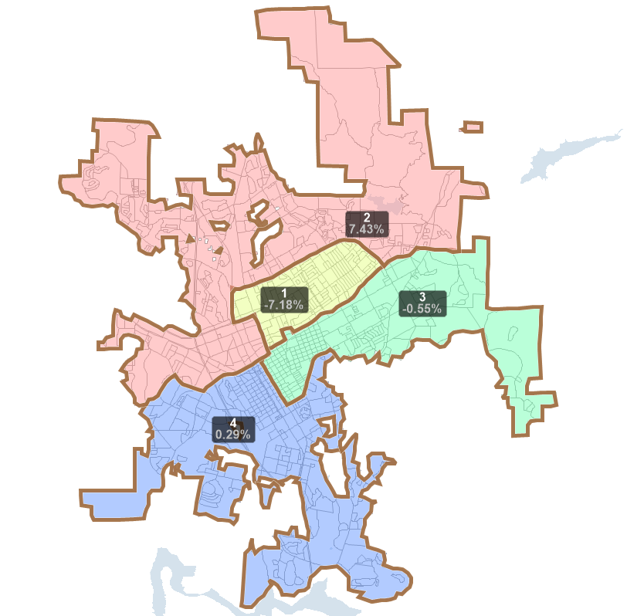
Current Deviations by Council District
District | % Deviation
1 | -7.18%
2 | +7.43%
3 | -0.56%
4 | +0.29%

Slide 7
Current Demographics by Council District
District | Population | % Deviation | Total CVAP | % Black CVAP | % Asian CVAP | % Latino CVAP | % White CVAP
1 | 35,159 | -7.18% | 17,851 | 3.28% | 6.91% | 53.64% | 33.24%
2 | 40,695 | 7.43% | 26,659 | 3.37% | 12.03% | 24.92% | 57.02%
3 | 37,672 | -0.55% | 22,048 | 3.82% | 6.33% | 39.26% | 47.56%
4 | 37,990 | 0.29% | 24,451 | 2.90% | 9.17% | 29.20% | 55.60%
*CVAP = Citizen Voting Age Population
Racial and ethnic characteristics of the Citizens Voting Age Population (CVAP) are tabulated according to Department of Justice standards.

Slide 8
Ideal Population Per District
To Compute the ideal population for each type of district:
Total population ÷ # of districts = Ideal POP
Escondido total Population from 2020 Census: 151,516
Ideal population for Escondido City Council Districts?
151,516 ÷ 4 = ~37,879 people per/district

Slide 9
Criterion 4: Local Neighborhoods and Communities of Interest (COIs)
Neighborhoods are specific to each jurisdiction
They are sometimes defined by the jurisdiction and more frequently by the residents that live in a certain area.
“Communities of Interest” are generally described as a geographic area comprised of residents who share similar interests.
COIs are defined by those familiar with the community...
Law does not limit the kinds of interests that may bind a community.
It is up to those who live in or work with a community to identify and establish the interests that unite it.
Interests need not be limited to current situation but can also include common goals.

Slide 10
Common Interest Examples:
Economic interests:
  Current situation -- common employment or economic opportunities (or lack thereof).
  Goals -- expanding opportunities, development, bringing in businesses, and jobs, etc.
Social interests:
  Current -- schools, culture, transportation, parks
  Goals -- improving recreational opportunities or public safety, preserving historic resources, etc.
Neighborhoods are often thought of as Communities of Interest

Slide 11
How to document your COI
Please answer the following questions:
What bonds your community?
  Outline what defines the COI:
  What is your mission or commonality?
  Explain what is different outside of the boundaries of your Community of Interest
Where is your community located in the City?
  Create a map of the boundaries (use Google maps, GIS/mapping program, paper, etc.)
  Write down the boundaries
  Use the State’s Community of Interest tool to map their COIs and submit them to the Commission (see redistricting website for instructions)
Please submit COI Testimony by January 21, 2022 to be considered in the first Draft Map(s).

Slide 12
Timeline Overview
January 5, 2022 - 6 p.m. (Public Input Hearing)
  District 1: Mission Middle School
January 8, 2022 - 9 a.m. (Public Input Hearing)
  District 2: Reidy Creek Elementary School
January 10, 2022 - 6 p.m. (Public Input Hearing/Mapping)
  District 3: East Valley Community Center
January 13, 2022 - 6 p.m. (Public Input Hearing/Mapping)
  District 4: San Pasqual High School
January 18, 2022 - 6 p.m. (Public Input Hearing/Mapping)
  District 1: Washington Park Recreation Center
January 20, 2022 - 6 p.m. (Public Input Hearing/Mapping)
  District 2: Park Ave. Community Center

Slide 13
Timeline Overview
January 24, 2022 - 6 p.m. (Commission Meeting)
  Escondido Council Chambers
January 27, 2022 - 6 p.m. (Commission Meeting)
  Escondido Council Chambers
By January 28, 2022: Preliminary Redistricting Plan Posted Online for Public Comment
February 3, 2022 - 6 p.m. (Public Feedback Hearing)
  District 3: Orange Glen High School
February 10, 2022 - 5 p.m. (Public Feedback Hearing)
  District 4: Del Lago Academy
February 17, 2022 - 5 p.m. (Public Feedback Hearing)
  Citywide: Escondido Library
February 23, 2022 - 6 p.m. (Commission Meeting)
  Escondido Council Chambers

Slide 14
Why should you participate?
To make sure we know about your Community of Interest.
To give your community a voice and make sure it has equal access to the political process.
To encourage citizens to register, vote, and remain politically engaged.
To help shape a redistricting plan that provides communities a meaningful opportunity to elect candidates who represent their interests on issues that are important to their lives.

Slide 15
How to Get Involved
To participate in the process: testify, submit written testimony, send supporting information to the Commission
Submit information at a hearing, by mail, or drop off at: Escondido Independent Redistricting Commission, c/o Escondido City Clerk's office, 201 N. Broadway, Escondido, CA 92025
Via email: redistricting@escondido.org
Via Phone: 760-839-4617
Get more information online: https://www.escondido.org/independent-redistricting

Slide 16
Thank you!
Questions?

